Slide 1

Verbatim theatre is theatre made from real people’s words. A form of documentary theatre, it allows theatre makers to explore events and themes through the words of people at the heart of them, and can be hugely influential.
Verbatim theatre is usually created from the transcription of interviews with people who are connected to a common event or subject.
The interviews are then edited into a performance text.
This research provides the both the spoken material for the play also a play’s characters. Characters in a verbatim play often represent a specific, real person. They may be identifiable, or their name and characteristics may be changed. Sometimes, characters may be amalgamations of more than one person.
Theatre which makes an audience think about social/moral issues.
Theatre which has a clear message.
WHAT IS THEATRE IS EDUCATION? (TIE)
Theatre which has a clearly ‘educates’/teaches an audience information.
Theatre which contains facts/information
Realism was a 19th-century theatrical movement, seeking to portray real life on the stage. Stanislavski was a committed follower of realism throughout his working life.
Theatre which has a specific ‘target audience’ / is aimed at a specific group of people
Theatre which is often targeted at children
Epic theatre is a theatrical movement arising in the early to mid-20th century from the theories and practice of a number of theatre practitioners who responded to the political climate
Naturalism - Emotional memory is when the actor finds a real past experience where they felt a similar emotion to that demanded by the role they are playing. They then ‘borrow’ those feelings to bring the role to life.
Musical Theatre is a genre in which the story is told through the performance of singing, spoken dialogue and, sometimes, dance.
Key words & Definitions
There are different types of songs in musicals, Character songs, Production songs and Action songs
Drama Techniques:
Freeze-frame/ Tableaux: creating a still ‘picture’ on stage.
Slow/Fast motion: Slowing/speeding up movement in a clear and deliberate way.
Narration: Explaining the story / emotions directly to the audience.
Multi-role: Playing more than one character.
Split-stage: Having one scene one and the next scene on the other side of the stage.
Thought tracking/ Thoughts aloud: saying what your character is thinking/feeling to the audience. Can also be used through ‘conscience corridor’.
Flashback/Flash-forward: Showing the audience a brief scene which shows back-story or the future events of the play. This is usually followed by then going back to the original moment
Physical Theatre: Using stylised movement and mine to ‘physicalise’ a story.
Direct Address: Speaking directly to the audience/getting them involved in the action. Can also be a ‘banner/placard/projection’ or narration will state a fact to the audience as well.
Third person: The third-person point of view belongs to the person (or people) being talked about. The third-person pronouns include he, him, his, himself, she, her, hers, herself, it, its, itself, they, them, their, theirs, and themselves. ... Talking in the third person is normal if you are talking about someone who is not you
Placard: a placard is a sign or additional piece of written information presented onstage. Using placards might be as simple as holding up a card or banner.

Slide 2
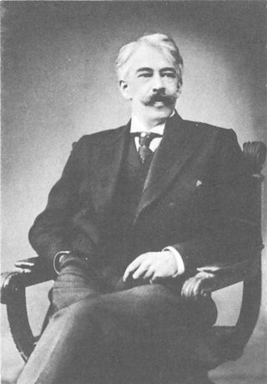
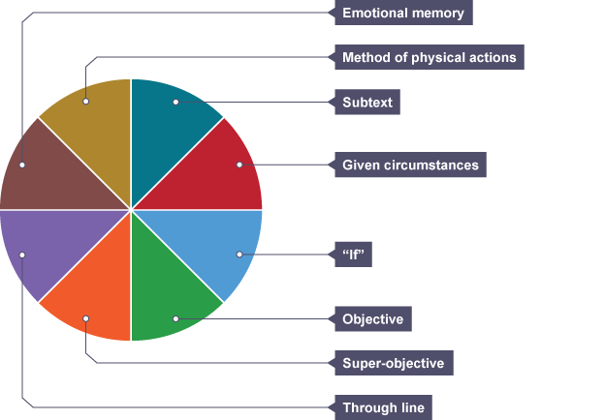
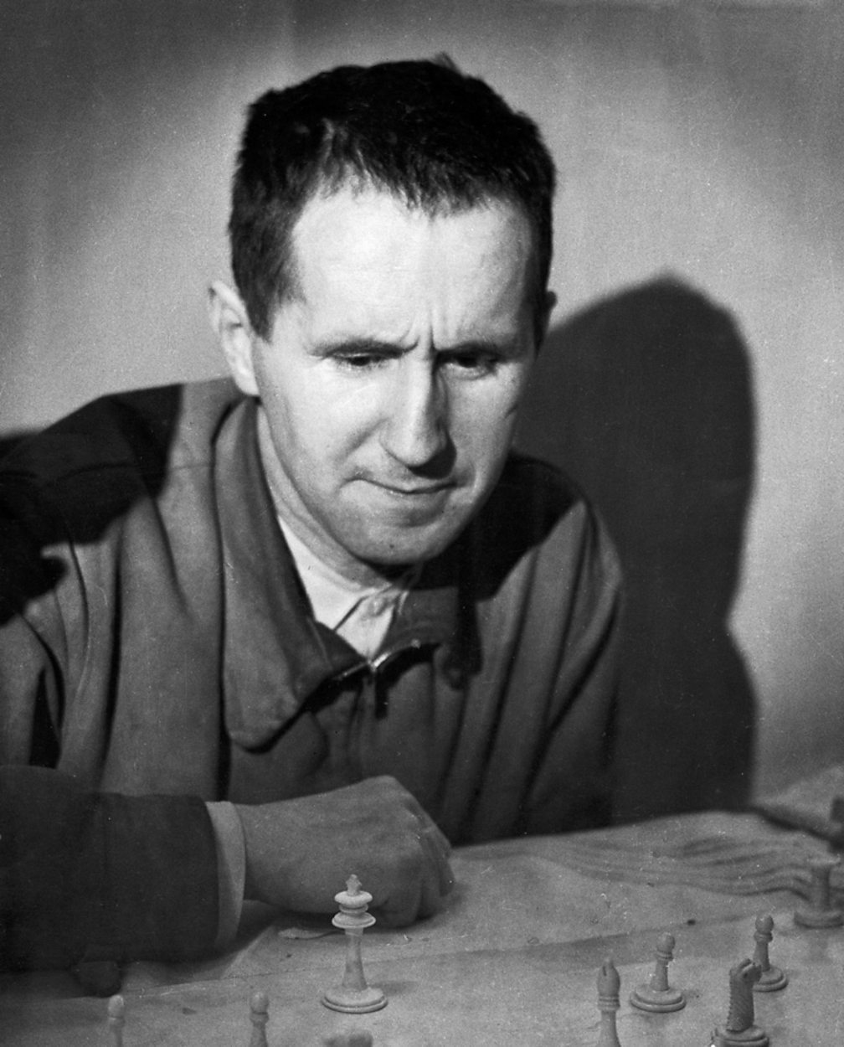
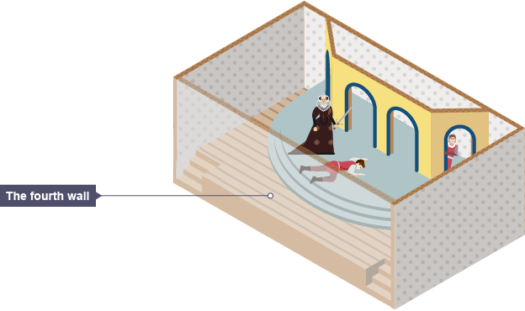

Konstantin Stanislavski
It’s very easy to over-simplify the method of Konstantin Stanislavski, one of the greatest and most influential of modern theatre practitioners. The main thing to remember is that he takes the approach that the actors should really inhabit the role that they are playing. So the actor shouldn’t only know what lines he needs to say and the motivation for those lines, but also every detail of that character’s life offstage as well as onstage. In this way we can establish Stanislavski as a director and practitioner whose productions are naturalistic.
Bertolt Brecht
The playwright Bertolt Brecht was born in 1898 in the German town of Augsburg. After serving as a medical orderly in the First World War and appalled by the effects of the war, he went first to Munich and then to Berlin in pursuit of a career in the theatre. Brecht's ideas are very influential. He wanted to make the audience think, and used a range of devices to remind them that they were watching theatre and not real life.
Konstantin Stanislavski’s System
The fourth wall. The set of a realistic production will be solid, three dimensional, and most often in a proscenium theatre that enhances the sense of that fourth wall. The performers present the action realistically, without using techniques such as addressing the audience or a tableau, which immediately shatter any illusion of real life being played out.
Styles, Genres and Practitioners

