Slide 1



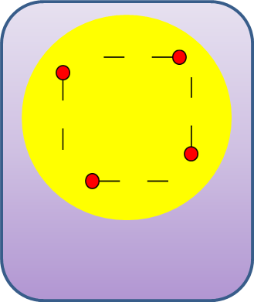

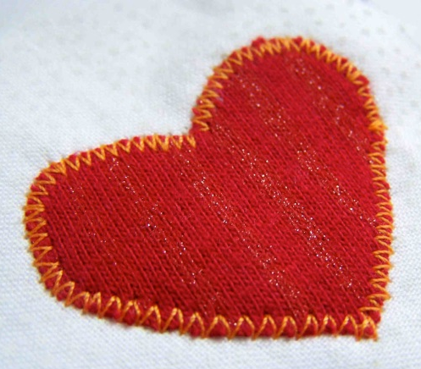
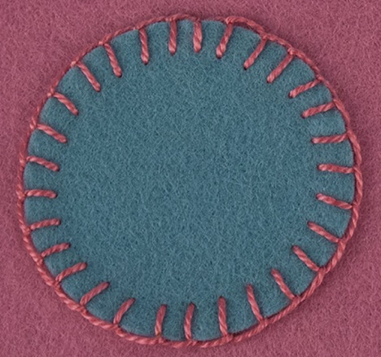
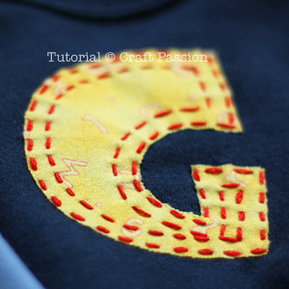
Equipment list:
Preparation:
Paper scissors
Paper
Pencil
Ruler (optional)
Construction:
Background fabric
Appliqué fabric
Fabric shears
Pins
Iron
Vilene/interfacing
Sewing machine
Bobbin
Thread
How to Applique
Prepare you fabric by ironing interfacing onto the back. Be careful the iron will be hot!
Step 1: Creating your template
Draw your desired shape onto paper with a pencil. Cut out using paper scissors.
Step 2: Cutting out your appliqué
Pin your paper template to your appliqué fabric and cut out using fabric shears.
Step 4: Stitching
Using hand embroidery or machine embroidery stitch around the edge to attach the two pieces of fabric together.
TIP: Stitch on slow speed to ensure you have more control of your fabric.
Step 3: Pinning
Remove the paper template from your appliqué fabric. Pin the appliqué fabric on to your background fabric.
Gold: A completed appliqué sample with a continuous neat stitch around the edge. The tension is consistent and the fabric lies flat.
Silver: A completed appliqué sample which shows a good level of skill on the sewing machine. Stitching is good with few mistakes.
Bronze: A mainly completed appliqué sample which shows some level of control when using the sewing machine. Have selected a simple style of stitch. Fabric may be warped slightly and not sit flat.
Machine Stitch
Blanket Stitch
Running Stitch

