Slide 1
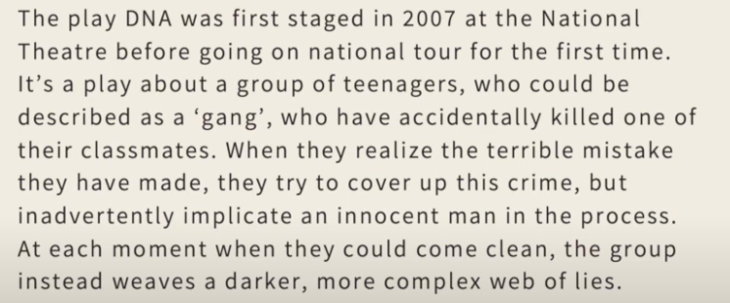
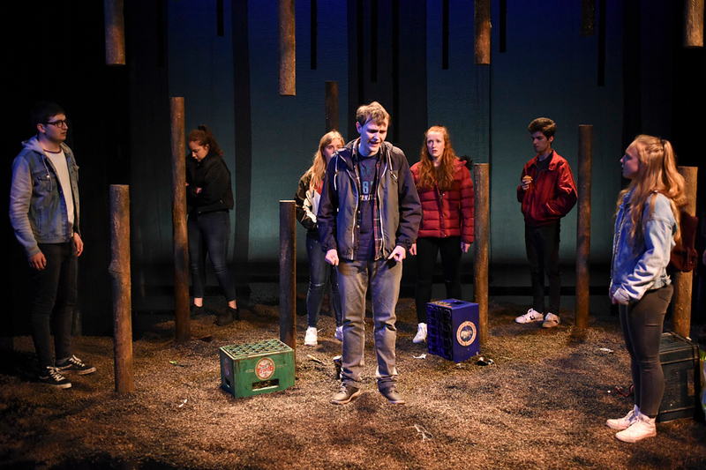
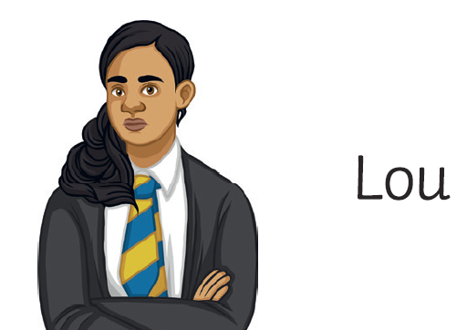
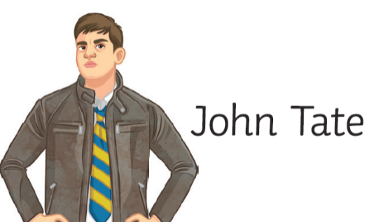
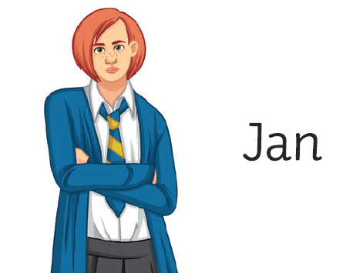
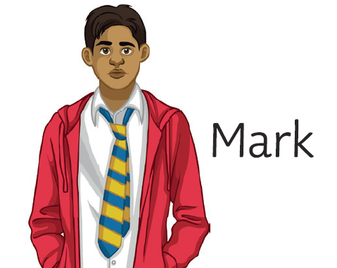
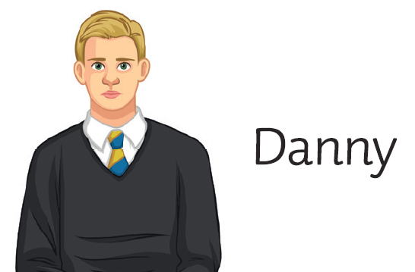
DNA by DENNIS KELLY
Plot
Born in 1970, wrote his first play when he was 30 years old.
We are screwed!!!
Considerations
Music
Freeze frame
Levels
Proximity
Physical contact
Characters
Direction
Emotion
Structure & Locations:
Stage directions
Key Themes
Gangs | Bullying | Morals
1. Street
The play contains a number of different themes. One of the obvious ones is bullying and the most obvious character who is bullied is Adam. He is desperate to be a member of the group and this means he is an easy target for the bullies. His bullying at the start of the play is so bad we believe this is the cause of his death. Even when he returns at the end of the play he is still bullied.
Another theme is gangs. The group of characters in the play can be described as a ‘gang’. We witness a few of the characters who, in their own way, want to be accepted as a member of the gang. They are willing to do things that they don’t really want to in order to ‘belong’. Morals is another theme as they are many moments within the play where you want the characters to do the right thing but mostly end up making the wrong choice.
2. Field
3. Woods

Slide 2
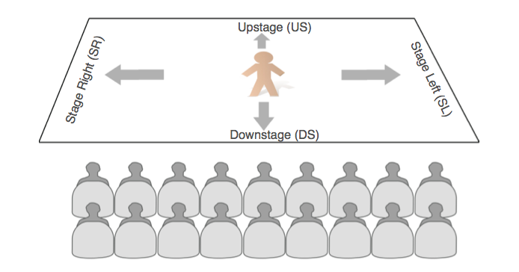
Volume | How loud or quiet you speak | Body language | The conscious and unconscious movements and postures by which attitudes and feelings are communicated.
Elongate | To make a word longer to create dramatic effect
Emphasis | the pressure on individual words that makes them stand out
Pause | the Dramatic Pause is a beat or two of silence with no dialogue and little or no music/background sound
Vocal Skill | Definition | Physical Skill | Definition
Tone of voice | This suggests your mood, emotion and your intention towards the listener | Gesture | A movement of part of the body, especially a hand or the head, to express an idea or meaning
Pitch | Speaking in a high, low or natural voice | Gait | The way in which a character travels on stage
Pace | The speed in which you speak | Facial Expressions | The emotion displayed through facial features
Diction | How clearly and precisely words are spoken | Mannerism | A habitual gesture or way of speaking or behaving
Accent | A way of pronouncing words that shows where you are from and your social class. | Posture | The way in which you hold your upper body
Stage Directions
Learning Lines
Annotate thoughts on why or how your character says the line. What are they trying to get from the other characters? What is there objective? How are they feeling? This information will help you learn the lines and the character’s emotions.
Write your lines out, one at a time. Read line 1 – cover it – write it – check it. Read lines 1 and 2 – cover it – write it – check it. Read lines 1,2 and 3 – repeat. If you get something wrong, go back over and repeat from the beginning.
Run your lines with another person. Give them the script and ask them to test you. This could be a friend or a sibling or anyone else at home. Ask them to not correct every tiny mistake but to note areas that need re-learning once you get through it. Again, repeat this as much as you can.
Memorise one line at a time. Similar to writing your lines out but this is in your head. Try practicing this on the bus to school. You cannot learn everything at once! Break it down to small manageable ‘bits’.

