Slide 1
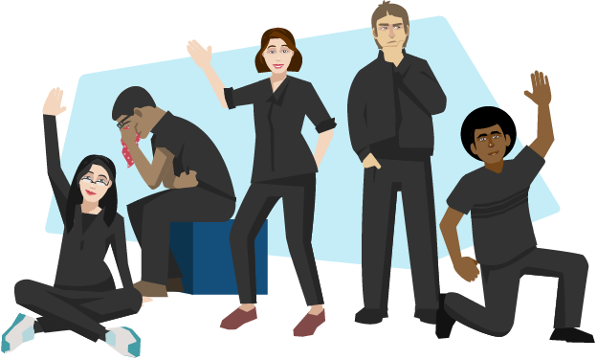
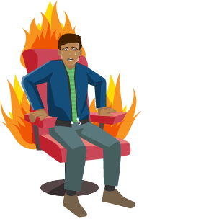
Montage
Create a sequence of still images exploring events,
This is a good way to explore the emotional journey through a scene. Putting images together in this way to tell a story is called a montage.
Thought-tracking
A thought-track is when a character steps out of a scene to address the audience about how they’re feeling. Sharing thoughts in this way provides deeper insight into the character for an audience.
In rehearsal it’s an effective way of exploring characters and scenes in greater depth. Stopping the action and sharing thoughts enables the actor to fully understand how their character thinks or feels at any given moment. Sometimes the character might feel something different to the words they’re speaking. This is called subtext and thought-tracking is a useful way of exploring it to realise the many layers within a scene.
Still image
This is a frozen picture which communicates meaning. It’s sometimes called a freeze frame or tableau. It can provide insight into character relationships with a clear focus upon use of space, levels, body language and facial expression.
Role on the wall
You could use a role on the wall diagram to help you. Divide an outline of a person in two from top to bottom. Write down what the character thinks and feels on one side and what other characters think and feel about your character on the other side. You can also include factual information about the role you are playing around the outside of the figure. This will help you understand your character better.
Narrating
Narrating is adding a spoken commentary for the audience about the action onstage. A narrator is like a storyteller informing the audience about the plot.
Hot Seating
This is an exercise to deepen understanding of character. An actor sits in the hot-seat and is questioned in role, spontaneously answering questions they may not have considered before.
Role play
This is the act of pretending to be somebody else, of taking on a role. The role may be from a script or a character you have created. Thinking, acting and even feeling differently to your ordinary self can help you empathise with that person and better understand an issue or theme.
This explorative strategy would be effective if you were using the work of Konstantin Stanislavski as your chosen style. He took the approach that the actor should inhabit the role that they’re playing. The actor shouldn’t only know what lines they need to say and the motivation for those lines, but should also know every detail of that character’s life offstage as well as onstage.
Cross-cutting is a device to move between two or more scenes staged in the space at the same time. It’s important that the audience know which part of the action they should follow so one part of the action remains in still image while another scene is played out, directing the audience’s focus.
Devised Strategies

Slide 2
Marking the moment
This is a way of highlighting the most important moment in a scene in order to draw the audience’s attention to its significance. There are various ways of marking the moment:
A still image might be used. Freezing the action at a particular moment fixes it in the minds of the audience and ensures its significance is not lost.
The key moment may be repeated or played ‘on a loop’.
Slow motion could be used to highlight a key moment, so that it is not lost on an audience.
Narration or a thought-track could be added as a commentary on what has just occurred.
Lighting and sound. A spotlight can be used to direct the audience’s focus towards the key moment and a sound effect can also draw attention to it.
Marking the moment is useful in rehearsal as it helps actors consider the most important moments communicated within a scene and ensures their impact is not lost upon the audience.
Forum theatre
Forum theatre was developed by a Brazilian theatre maker called Augusto Boal. It’s a very useful tool for exploring drama during the rehearsal process. Company members become ‘spect-actors’ rather than spectators. This means that while watching work they can stop it and take the place of an existing performer to try out a new idea. Sharing ideas in this improvised practical way can provide fresh insight into a role and stop the drama from becoming stale.
Choral speech
A speech spoken by more than one person. Can be spoken in unison or with words and phrases repeated or echoed through the speech
Flashback
A scene enacting something that happened in the past; the enactment of a character's memory of a past event.
Monologues
A monologue is when one solitary character speaks to the audience and shares their feelings or point of view.
A stimulus is anything which excites your imagination and sows the seeds of a piece of drama. It could be an existing script, a piece of fiction or non-fiction, a poem, an object, a picture, a newspaper or web article, or a piece of music.
Need more information? Head to the student shared area – departments – Drama – Devised Drama
Devised Drama Component Two
40% of your overall Drama GCSE
Top Tips
Three written logs and one performance:
Log 1 – Response to a stimulus
Log 2 – Development and Collaboration
Log 3 – Analysis and Evaluation
Performance
All sections of the devised drama are worth 20 marks.
Be organised
Put in extra rehearsals
Complete ALL homework
Use the Drama techniques
Apply feedback
Research
You will find:
Help booklet for logs
Explorative strategies booklet
Marking criteria

