Slide 1
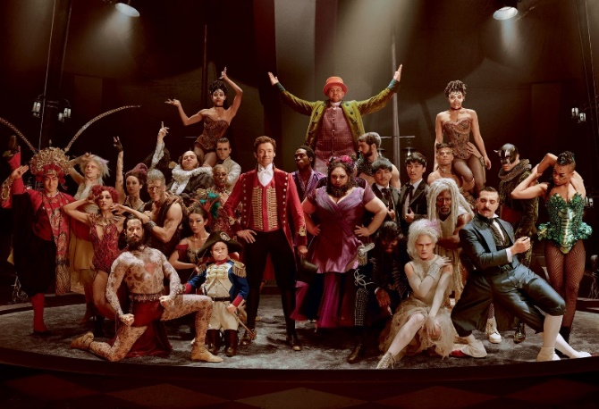
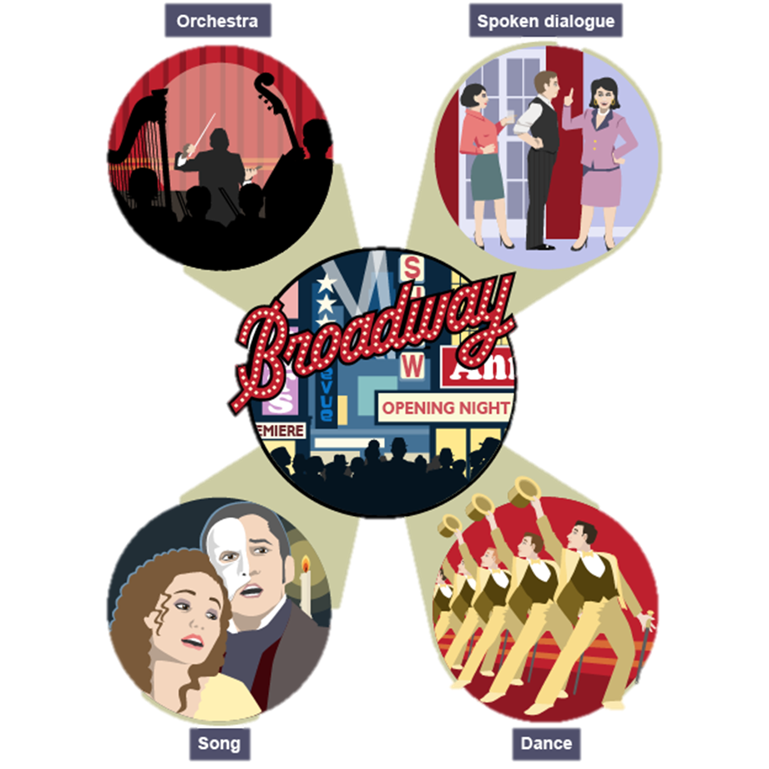
Key Features of the genre Musical Theatre
Year 9 Dance
Unit 2: Professional Dance Study
What is the
dance style?
https://www.youtube.com/watch?v=NbDgfOTsHDA
Link to the dance
Musical Theatre: is a genre of drama in which singing and dancing play an essential part.
Title of film: The Greatest Showman
Name of dance: ‘Come Alive’
Name of choreographer: Ashley Wallen
Dance style: Musical Theatre
Set in: New York City, 1850’s
Key info…
Musicals are set out to entertain through a combination of:
catchy music in a popular style
solo songs, duets, choruses and ensembles
orchestra or band accompaniment
spoken dialogue
dance sequences, stage spectacles and magnificent costumes
These are all held together by the plot.
Performance Criteria:
Posture
Timing
Movement memory
Extensions
Facial expressions (smile)
Project your energy
100% effort throughout

