Slide 1
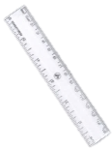





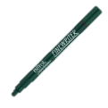
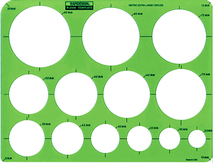

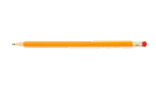





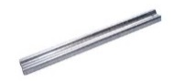

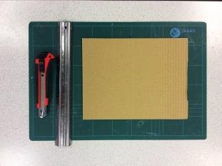
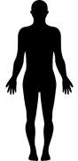
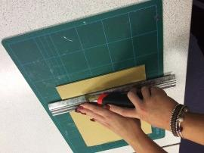
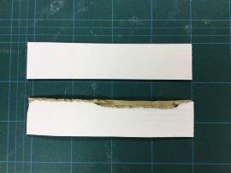

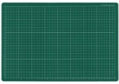
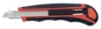
Equipment
Sketch
Outline
Erase
Colour
Skill: Sketching
You will need:
Pencil
Fine liner
Rubber
Circle stencil
Ruler
Coloured pencils
Sketched in pencil.
Ruler used for straight lines.
Circle stencil used for curves.
Outlined with fine liner.
Ruler used for straight lines.
Circle stencil used for curves.
No visible pencil lines.
Coloured inside the lines.
Shaded tone (dark to light)
Target Market
Aesthetics
Function
Inspiration
Evaluate
Skill: Annotating
Who is the design aimed at?
How does the design appeal to that target market?
Describe how the design looks:
Shape
Colour
Font Styles
Material
* Use lots of adjectives! *
How does the design work?
Does the design do the job it is meant to do? How?
What has the design been inspired/influenced by?
What did you like about the inspiration?
Do you like the design? Why?
How could the design be improved?
Will you use the design as a final outcome?
Equipment
Layout
Safety
Align
Cut
Skill: Cutting
You will need:
Material
Cutting mat
Craft knife
Metal safety ruler
All equipment is laid out on an empty desk.
Material placed on top of the cutting mat.
Stand up when cutting.
Space from other pupils/desks/chairs.
Metal ruler to the left of the cutting line.
Index finger on the top
of the craft knife.
Repeated cutting action
(at least 3 times)
Accurate clean cut through the material – no rough edges.

