Slide 1
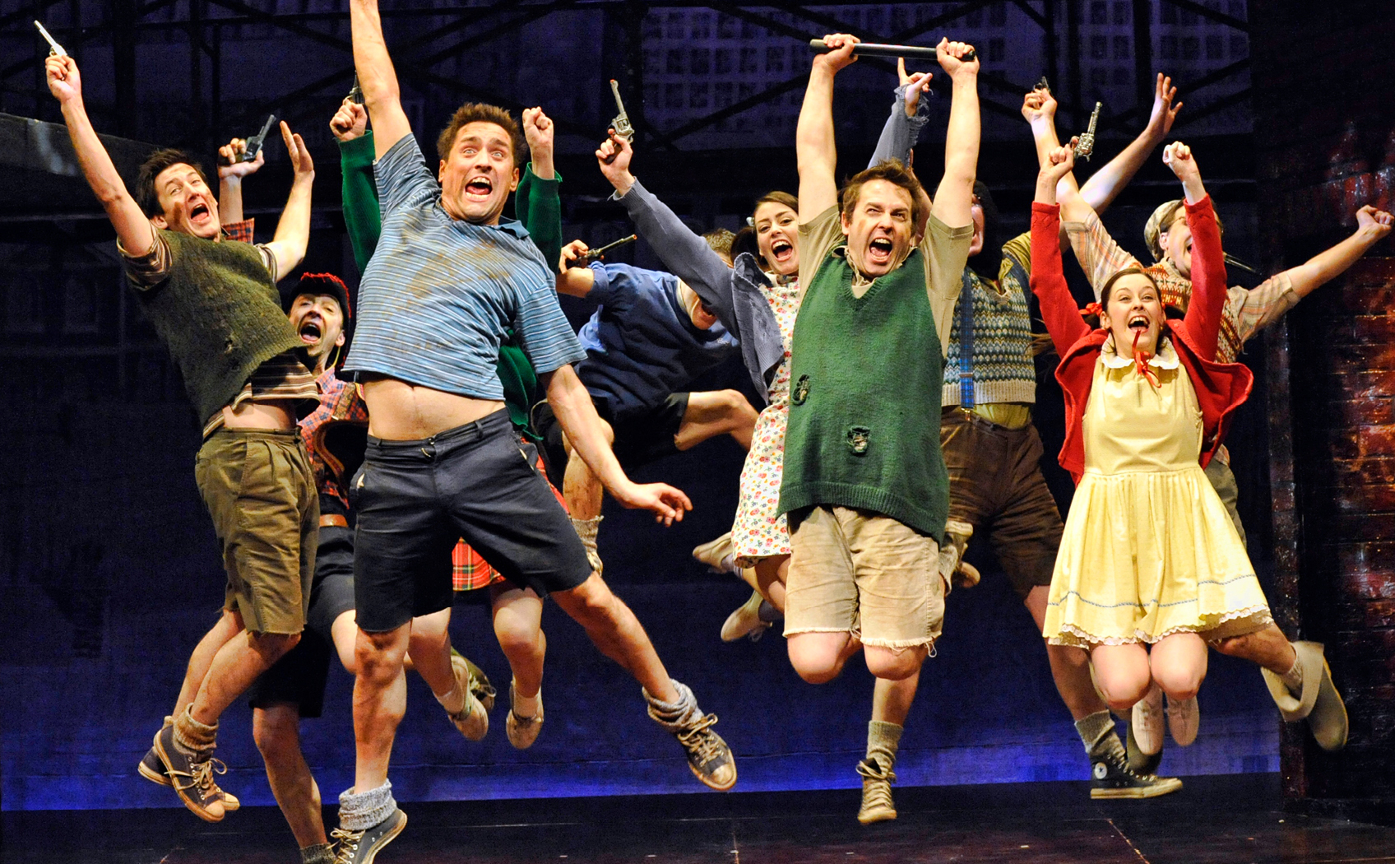
Fabric
Leather
Linen
Wool
Silk
Cotton
Polyester
Chiffon
Colours, prints, patterns and decorations
Prints: floral, checked, polka dot…
Multi coloured
Lace
Dyed
Natural colour
Sequins
Cheaper fabric
Expensive fabric
Footwear
Sandals
Boots
Buckles, laces, straps, ribbons, Velcro, stitching
Slippers
Brogues
High heeled stiletto
Decorative detail:
Buttons: Size, colour, plain or decorative
Embroidery: Decorative stitching
Trim: Additional decorative items such as fur on the collar of cuffs of a jacket or a fringe on a skirt
Colour palette:
The range of colours of colours used
Colour coding:
Using colours to indicate something about the characters, such as a family group or to suggest a characters transition by moving from muted tone to bright colours.

Slide 2
Key Words
Analysis:
To show his/her middle class status
To show his/her working class status
To show she/he has been playing out
To show she doesn’t have much money
To show the clothing has been passed down from older siblings
To show Mrs Lyons has the time to press Edward’s clothing and present him well
To help show the mood of the scene which is…
Describe - to give an accurate account of something in detail.
Analyse - to examine something in detail and explore why choices were made.
Extract – A short passage taken from the play
Hairstyle:
Short, Long, Styled?
Tip – It is important that you can explain your design choices. For example, have you chosen bright clothing to show that he has an outgoing personality? Or chosen heavy boots which may make him seem more dangerous or threatening? Does he take care of his appearance or model himself on people he admire?
Headwear:
Hat?
Cap?
Bobbles? Clips?
Make up?
Clean-shaven or stubble? Clear complexion or spots?
Jacket: Leather? Cotton? Polyester? Fit: Loose? Fitted? Tailored?
Shape: Long? Short?
Shirt: Plain? Patterned? Tucked in or left out? Long sleeves or short? Rolled up or not?
Footwear: Trainers? Boots? Loafers? Materials: Suede? Leather? Cloth?
Trousers: Jeans? Chinos? Suit? Fit: Loose or tight? Short or long? Rolled or not? Condition: Worn or new? Patched?
Accessories: Watch? Bandana? Belt? Other?

Slide 3
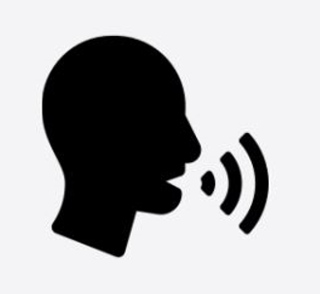
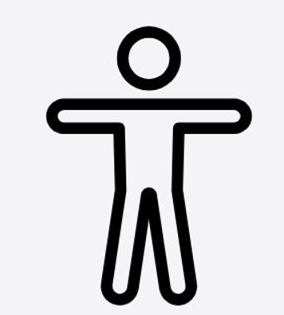
Vocal Skill | Definition | Physical Skill | Definition
Tone of voice | This suggests your mood, emotion and your intention towards the listener | Gesture | A movement of part of the body, especially a hand or the head, to express an idea or meaning
Pitch | Speaking in a high, low or natural voice | Gait | The way in which a character travels on stage
Pace | The speed in which you speak | Facial Expressions | The emotion displayed through facial features
Diction | How clearly and precisely words are spoken | Mannerism | A habitual gesture or way of speaking or behaving
Accent | A way of pronouncing words that shows where you are from and your social class. | Posture | The way in which you hold your upper body
Volume | How loud or quiet you speak | Body language | The conscious and unconscious movements and postures by which attitudes and feelings are communicated.
Elongate | To make a word longer to create dramatic effect
Emphasis | The pressure on individual words that makes them stand out
Pause | This is a beat or two of silence with no dialogue and little or no music/background sound

Slide 4
