Slide 1
Welcome to Hillcrest School and Sixth Form Centre
Year 9 KS4 Options
‘Quality Learning, Quality Care’

Slide 2
Aims of the Key Stage 4 Curriculum
Qualifications should:
Reflect our changing world
Prepare our students to be successful in society
Engage students in learning
Prepare students for study at college or university, or for work.
Education should not be a ‘one size fits all’ system.
We recognise our students have:
Different needs of our students
Different learning styles
Different aspirations and goals

Slide 3
Core Subject
All students will study the following subjects:
English Language and Literature
Mathematics
Combined Science (Biology, Chemistry and Physics)
French
Non-exam subjects
Physical Education
Religious Education (Year 10 only)

Slide 4
Optional Subjects
Students must then choose subjects to fill the optional parts of the timetable. There are three option spaces to fill, one of the options must be either History or Geography.
Option A
Option B
Option C

Slide 5
Option A Subject
GCSE History
GCSE Geography
GCSE Psychology
GCSE Food Preparation and Nutrition
Sport BTEC Level 2 First Award Sport
GCSE Spanish

Slide 6
Option B Subject
GCSE Ancient History
GCSE Geography
BTEC Level 2 Tech Award in Performing Arts: Drama
BTEC Level 2 Tech Award in Performing Arts: Dance
GCSE Philosophy and Ethics
GCSE Computer Science

Slide 7
Option C Subject
GCSE History
GCSE Geography
GCSE Triple Science - To qualify for Triple Award Science, students must have completed the higher-level assessments and spoken to their class teacher.
GCSE Music
GCSE Art and Design – Fine Art
GCSE Art and Design – Textiles

Slide 8
Reserves
Students will select a reserve from each option block. Reserves will be considered in an event where a subject is no longer available. Subject availability is dependent on the number of students who opt for the subject.

Slide 9
GCSE Reform
Current Y10 and Y11 students are already following revised & reformed GCSE Specifications in the majority of their subjects
These are awarded numerical grades from 9 to 1 – 9 is the highest, 1 is the lowest
A grade 4 is the new standard that a student is expected to achieve in order for them to have passed the qualification. This is equivalent to the old C grade.
A grade 5 is considered a “good” pass. This is roughly equivalent to the top portion of the previous C grade and the bottom portion of the previous B grade.

Slide 10
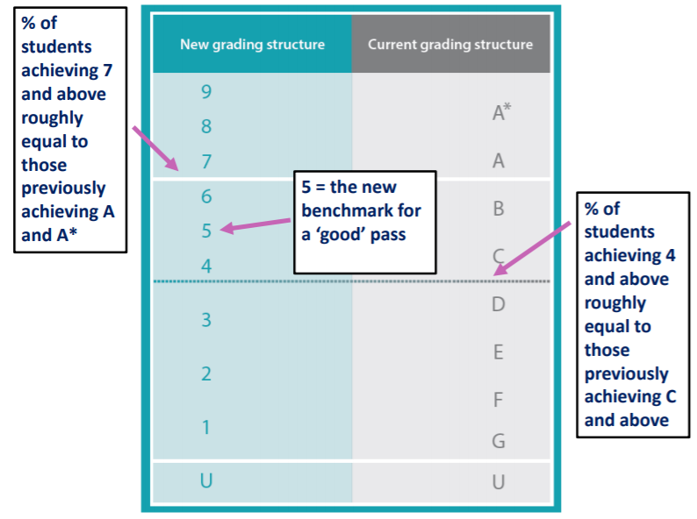

Slide 11
Making Good Choices
We strongly advise students to:
Think about their strengths and weaknesses
Think about how they prefer to study and learn
Find out how the courses are taught and assessed
Keep their choices broad and balanced
Research any career ideas they may have
Notes:
This is about your future so please do not choose subjects just because your friends are doing them or because you like the teacher. You must choose the subjects that you want to do and those that you feel that you will be successful in. Talk to your subject teachers, review tutors and parents as they will also guide and advise you about which courses are most suitable for you.

Slide 12
Making Good Choices
We strongly advise students not to make choices :
Their friends’ choices
Their current
One narrow career path
Notes:
This is about your future so please do not choose subjects just because your friends are doing them or because you like the teacher. You must choose the subjects that you want to do and those that you feel that you will be successful in. Talk to your subject teachers, review tutors and parents as they will also guide and advise you about which courses are most suitable for you.

Slide 13
Next Steps
Please encourage your child to speak to the class teacher of the subjects they are considering
Year 9 Online Parents Evening – Monday 15th March 16.00-18.00
Students will complete an online form with their initial interest by Friday 12th February.
Updated online options form will be sent to students on Monday 22nd February.
If you have any questions please email Mrs Palmer – Assistant Headteacher on spalmer@hillcrest.bham.sch.uk
Deadline for Options Forms – Monday 22nd March 2021

