Slide 1
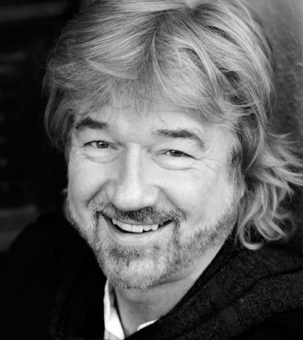




Playwright
Willy Russell.
Born in 1947 into a working-class family near to Liverpool.
Brought up by his mom and aunty.
He has a love of popular music and this can be seen in many of his plays, but especially in Blood Brothers.
Wrote ‘Our Day Out’ in 1977 which is based on his experience whilst teaching at Shorefields School in Liverpool.
Vocal Skills
Genre: Comedy/Realism/Satire: Russell’s plays and novels are about ordinary working class people. His collection of work is funny and moving with a comic touch.
The use of humour, irony, exaggeration
Skill | Definition
Tone | This suggests your mood and your intention towards the listener, e.g. happy, sad.
Volume | How loud or quiet you speak
Pitch | Speaking in a high, low or natural voice.
Pace | The speed in which you speak.
Emphasis | This is the pressure on individual words that makes them stand out.
Pause | To stop for a moment to create dramatic effect.
Summary: Mrs Kay’s Progress Class are unleashed for a day’s coach trip to Conwy Castle in Wales. The day does not go entirely as planned.
Physical Skills
Skill | Definition
Facial expressions | Showing emotion through the facial features.
Gestures | An expressive movement of the body.
Posture | They way in which you hold your upper body.
Body language | Communication through movement or positions of the body.
Gait | The way you travel in character.
Main Characters
Mrs Kay | A kind-hearted and generous teacher of the “progress class”
Mr Briggs | The deputy-head of the school who believes in very strict discipline
Colin/ Susan | Young teachers who are helping support those on the trip
Carol | A thoughtful student who seems unhappy with her life in Liverpool
Reilley/ Digga | Older students who used to be in the progress class: a bad influence on the others
Linda | A girl with a bad attitude: she has a crush on Colin and clashes with Mr Briggs
Andrews | A young student with a difficult home life.
Drama Techniques
HOT SEATING: Is a strategy in which a character is interviewed by the rest of the group. This activity allows you to think deeply about your character and develop important skills such as; communication, creativity and confidence.
BLOCKING: The precise staging of actors in the performance space.
Hot Seating:
Themes:
Social Class
Education
Poverty v’s Wealth
ROLE ON THE WALL:
A method where you are able to think deeply about your characters thoughts and feelings.

