Slide 1
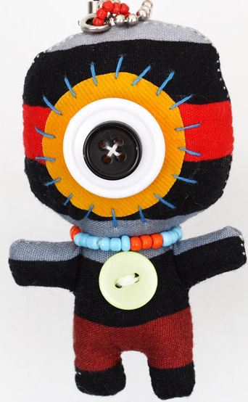
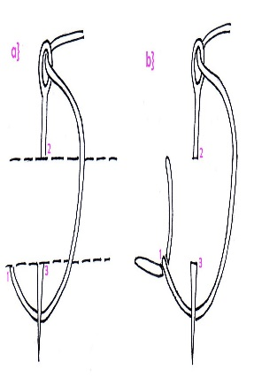
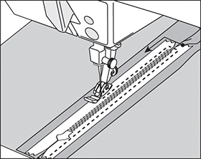
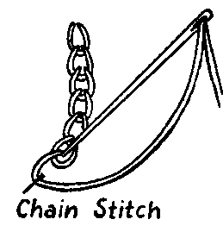
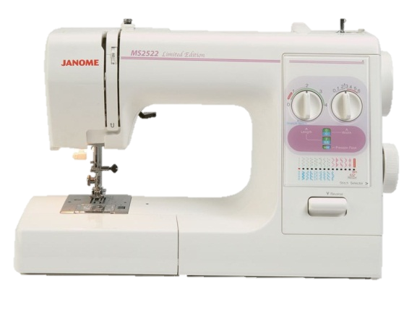
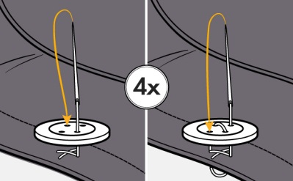
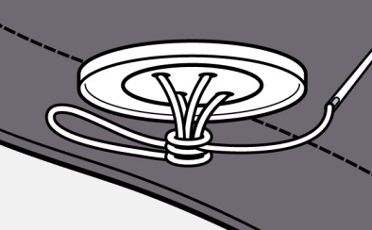
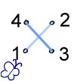
Right side – Template- Sew-
Seam allowance – Applique –
Embroidery- Fabric-Cotton
Year 8 Wall hanging Project : MAKING
Seam allowance = 1.5cm
SKILLS
Creating a template
Applying a seam allowance
Cutting fabric using a template
Pinning and tacking
Applique
Sewing on buttons
Basic sewing machine skills
Sewing on a zip
Making a pocket
Creating 3D parts
Correctly applying the ‘right side’ of the fabric
PROJECT OBJECTIVES::
Design a product suitable for a specific person and need
Develop greater accuracy and apply components
Produce a 3D end product
Double hem fold 1cm twice
Applique
Cut out your template .
Pin your template to your fabric.
Cut around the template.
Pin and tack the shape onto your background fabric.
Sew around the edge of the shape.
Add further decoration if you want to.
SAFETY: One person on a sewing machine / 4 H rules/ Carry equipment correctly
Blanket stitch
Level 4
Use the correct tools and pay attention to accuracy
Level 5
Use a range of tools and components with precision
Level 6
Produce a successful end product and explain any changes you made
Sewing binding…
Machine Applique
Length
Hand Embroidery…
Width
Stitch Selector
CHECK your stitch settings
Straight stitch = L2 W0
Zig Zag stitch = L1.5 W5
Cross Stitch
Sewing on a button…

