Slide 1
Year 8
Knowledge Organisers

Slide 2
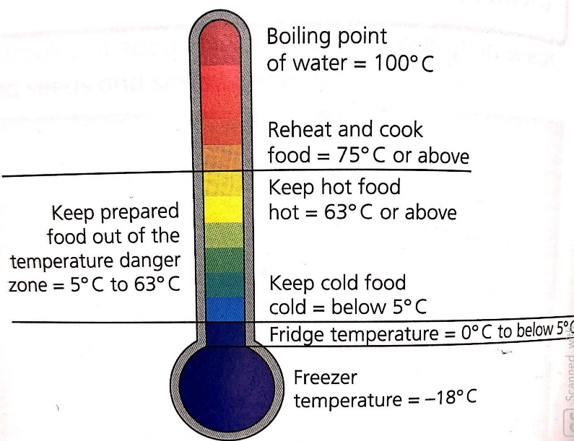
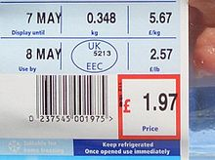
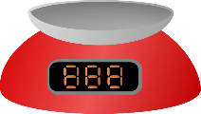




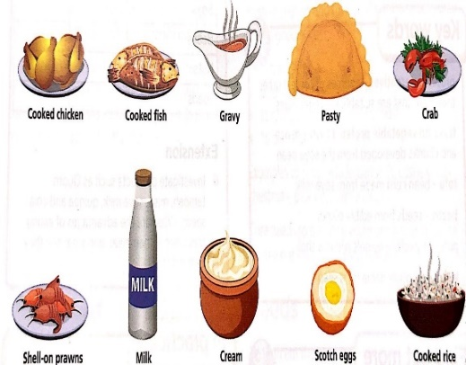
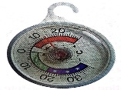
Year 8 - Why is temperature control important?
WWW Cooking and Nutrition
Can follow health and safety practices
Can use CCC’s
Can use a food probe correctly
Can follow a process plan to make a ____________
Can create a quality outcome – edible, safe to eat, appealing
Recording CCC’s including temperature control
Teacher Assessment
To plan and make a food product using ‘critical control checks’.
Success Criteria
To apply quality control checks to the process steps of making the cheese cake
To produce a quality outcome
Edible
Safe to eat
Appealing
Plan the making of a quality food product
Product Name:
Ingredients: List the ingredients to be used | Storage Conditions: Write down the storage conditions of each ingredient – frozen -18 C, chilled 0-5C or ambient.
Process of Making: Include a step by step instructions on how to make your food product Organise self, unit and washing up area. Place ingredients on tray Include the use of key words –bridge claw dice slice whisk beat | CCC’s Record a CCC next to the appropriate step of making eg when a Cheesecake is chilled check the temperature of the chilled product with a food probe. Is the temperature between 0-5C. Timings of making could also be added.
Temperature control is very important when you buy, store, prepare and cook food
food correctly will Storing minimise the risk of food spoilage and food poisoning
Food poisoning can be caused by high risk foods when they are stored in warm conditions for too long
Controlling the temperature of food will help keep your food safe until it is ready to be eaten.
Critical Control Checks:
In-date ingredients
Weight and measurements
Timings
Temperature control
Size and shape
Checking that food is out of the danger zone
When cooking use a temperature probe to check the food
Has reached the correct temperature.
Thermometers can be put in the fridge and freezer to check these are
Working at the correct temperature.
Preventing food poisoning
When using high risk ingredients/food products
Bacteria grow best in the danger zone which is between 5◦C and 63◦C
Below 5◦C they are dormant, this means that grow very slowly or not at all
Above 63◦C they are mainly destroyed by the heat
Food poisoning: an illness caused by eating contaminated food
High-risk foods: ready-to-eat moist foods, usually high in protein
Bacteria: microscopic living organisms, which are single-celled and can be found everywhere
Temperature Danger Zone: temperatures between 5◦C and 63◦C where most bacteria can multiply

Slide 3
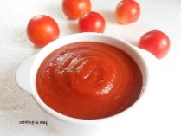

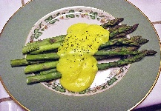
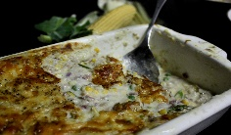
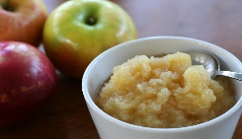
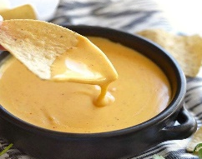
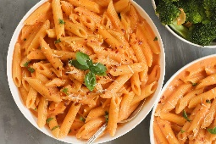
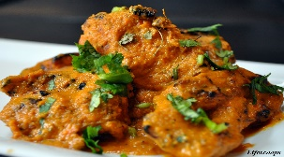
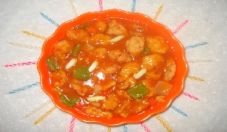
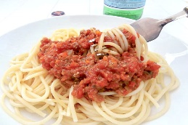
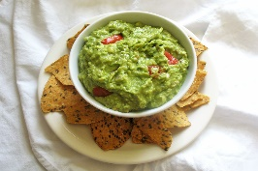

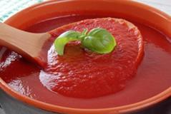
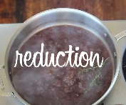
Year 8 -Sauces – What are they? Why are they used? How are they made?
Examples of British Sauces
Gravy is probably the best known sauce. Served traditionally with a roast dinner.
Cheese sauce can be adapted to go with fish, vegetable, poultry, and egg dishes.
Tomato sauce is an extremely versatile sauce. Excellent with homemade burgers.
Hollandaise sauce is a classic - serve with fish, egg, chicken and vegetable dishes.
Apple sauce is traditionally served with pork and cranberry sauce with turkey.
A Sauce is a well-flavoured liquid which has been thickened.
Sauces are added to food to:
Provide colour, flavour and texture
Bind different ingredients together
Make the dish look more appetising and attractive
Knowledge - Sauces
Starches can be used to make sauces, gravies and glazes.
Starch-based sauces
Starch is the main food source of plants.
It is made up of molecules of glucose.
Starch is very useful because it can thicken mixtures
When liquids and starch are mixed together and heated
the mixture will thicken. This process is called gelatinisation.
Starch-based sauces are usually thickened with either flour,
cornflour or arrowroot.
Indian cuisine - uses tomato based curry sauces, tamarind sauce, coconut based sauces
Mexican - salsa, guacamole, hot sauce and mole are all integral to Mexican cuisine.
Italian – Sauces in Italian cuisine include: Bolognese, arrabiata, pesto, and marinara sauce.
French cuisine – some classic sauces are Bechamel, roux, veloute and Hollandaise.
Chinese cuisine - uses soy, hoisin, oyster, sweet and sour and chilli bean sauce.
Making a roux
The roux method is a traditional
way of making a white sauce.
A roux is made by mixing melted fat and flour.
In the traditional recipe milk is added gradually
and the white sauce comes to the boil and thickens.
In the all-in-one recipe the cold milk is added to the
cold fat and flour. The sauce is stirred continuously
as the fat melts and gelatinisation occurs.
Roux Sauce
Gelatinisation is the name of the process for when starch granules are mixed with a liquid and heated; they swell and break open, causing the liquid to thicken.
Self Assessment:
List 3 reasons why you would use a sauce.
Watch this video clip https://resources.dynamic-learning.co.uk/Titles/FoodKS3T_L_9781510458208/a5e33289-0e72-4492-a970-53ebb50d681d/Resources/KS3Food_02450.mp4
Explain the process of gelatinisation,
In Practice:
Make a British and International dish which uses a sauce such as spaghetti Bolognese, pasta bake or vegetable curry,
Reduction Sauce
Reduction sauces are made when liquid is simmered over heat so that the water content evaporates; this leaves a concentrated, well-flavoured sauce.

Slide 4







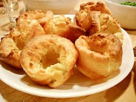
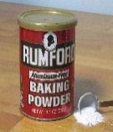
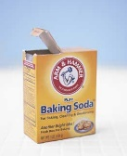
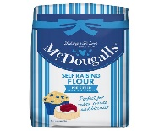
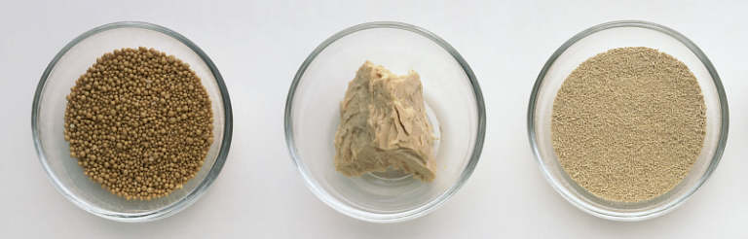
Year 8 Raising Agents- What are they? Why are they used?
Mechanical raising agents are air and steam. When air is incorporated into a mixture, the mixture rises.
Air can be introduced mechanically in several different ways.
Raising agents are added to mixtures to make them rise.
When you heat a mixture that contains a raising agent, the gas within it expands and then rises. Some gas escapes and some is trapped in the mixture. The gas sets when it cooks and then cools.
Many baked items such as breads, pastries, cakes and biscuits depend on raising agents for their soft, light, springy texture.
Without raising agents cakes, bread and scones would be flat
The 3 types of raising agents are chemical, mechanical and biological.
Whisking | Eggs or egg whites are whisked. This traps air bubbles in the egg white.
Beating | Liquids are beaten and air bubbles are trapped in the liquid.
Folding | Layers of air are trapped between the layers of pastry when the pastry is folded. During baking, the air expands between the layers and lifts the pastry. Using a spatula or spoon to fold a light ingredient(such as egg whites) into a heavier ingredient.
Sieving | Sieving flour traps air between the flour particles.
Creaming | Beating fat and sugar together traps tiny air bubbles into the mixture. When heated, the mixture sets and stops the bubbles from escaping.
Rubbing-in | Rubbing fat into flour traps air into mixture.
Biological Raising Agent.
Yeast is a biological raising. It is a single-celled plant fungus. Yeast is the raising agent used in bread, doughnuts and current buns.
Fermentation is the process in which yeast produces CO2 and alcohol. The yeast requires food(flour, sugar), moisture (water), warmth (environment and from the oven). The CO2 gas expands and collects as small bubbles. This will make the dough rise. When the dough is baked in the oven, the yeast is killed, the alcohol escapes and the dough sets.
Types of yeast:
Fast acting ‘easy bake’ dried yeast –Added to the flour before the warm liquid. Stored in cupboard for many months. We use this in school.
Fresh yeast – moist, cream-coloured block. Blended with warm water and sugar to activate the yeast. Stored chilled.
Active dried yeast – Small granules that are mixed with warm water and sugar to activate the yeast. Stored in cupboard for many months.
Chemical Raising Agents produce the gas carbon dioxide when they are heated with a liquid.
Baking powder reacts with moisture and heat to produce CO2. The CO2 forms small bubbles in the mixture, which make it rise. Once cooked the result is a well-risen, light, baked product. Baking powder is added to make Self Raising flour during production. Used as a raising agent in cakes and scones
Bicarbonate of soda (baking soda) also produces CO2 when heated, forming small bubbles which make it rise. In order for it to produce CO2 it needs moisture and an acid such as yoghurt and buttermilk.
Bicarbonate of soda can add a soapy taste so it is used in recipes where it can be disguised by other flavours. It is used as a raising agent in soda breads and strong-flavoured cakes such as gingerbread, fruit cake and chocolate cake.
Steam is produced during cooking from water or other liquids in the mixture as it is heated to boiling point in the oven. The oven temperature must be hot for this to happen.
Steam is used in Yorkshire puddings, choux, puff and flaky pastry.
Self Assessment:
What is a raising agent? Describe what happens when you heat a mixture containing a raising agent?
Which raising agents are added to gingerbread?
Which raising agents are added to bread?
Which raising agents are added to Victoria Sandwich?
Which raising agents are added to Yorkshire pudding?
Watch this video clip https://youtu.be/OUSi4DbRVVQ
Explain the conditions required by yeast.
In Practice:
Make a dish which uses air or steam as a mechanical raising agent, such as a savoury soufflé omelette, Swiss roll, pavlova or a whisked flan.
Fast acting ‘easy bake’ dried yeast
Active dried yeast
Fresh yeast

Slide 5
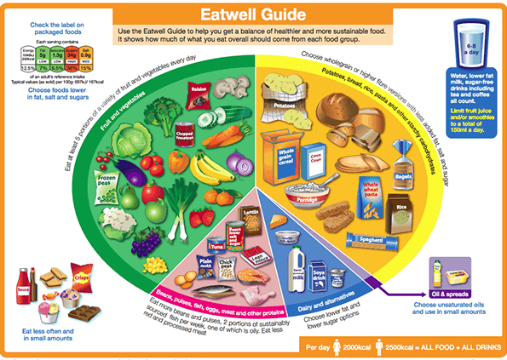
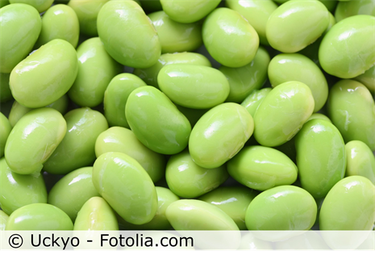
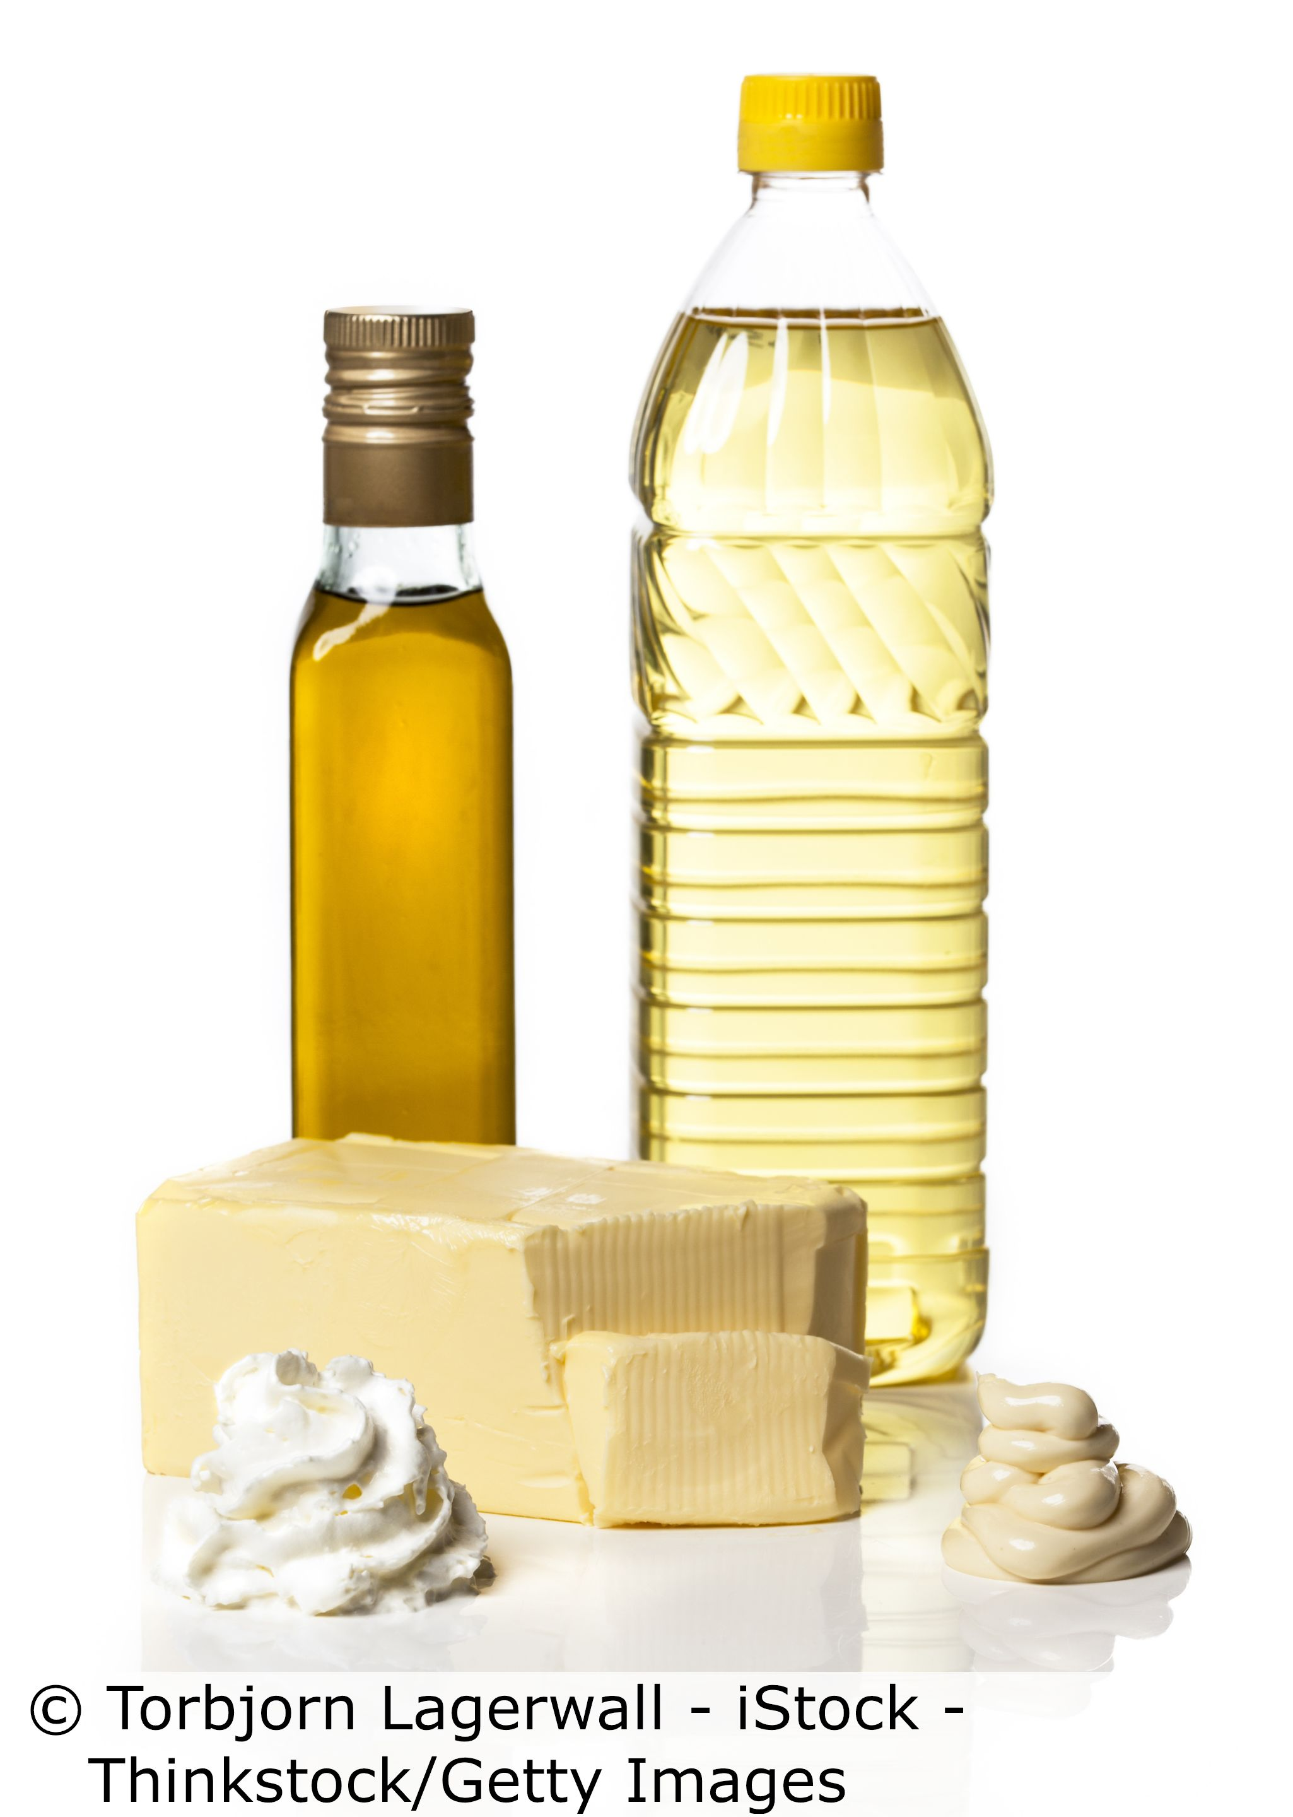
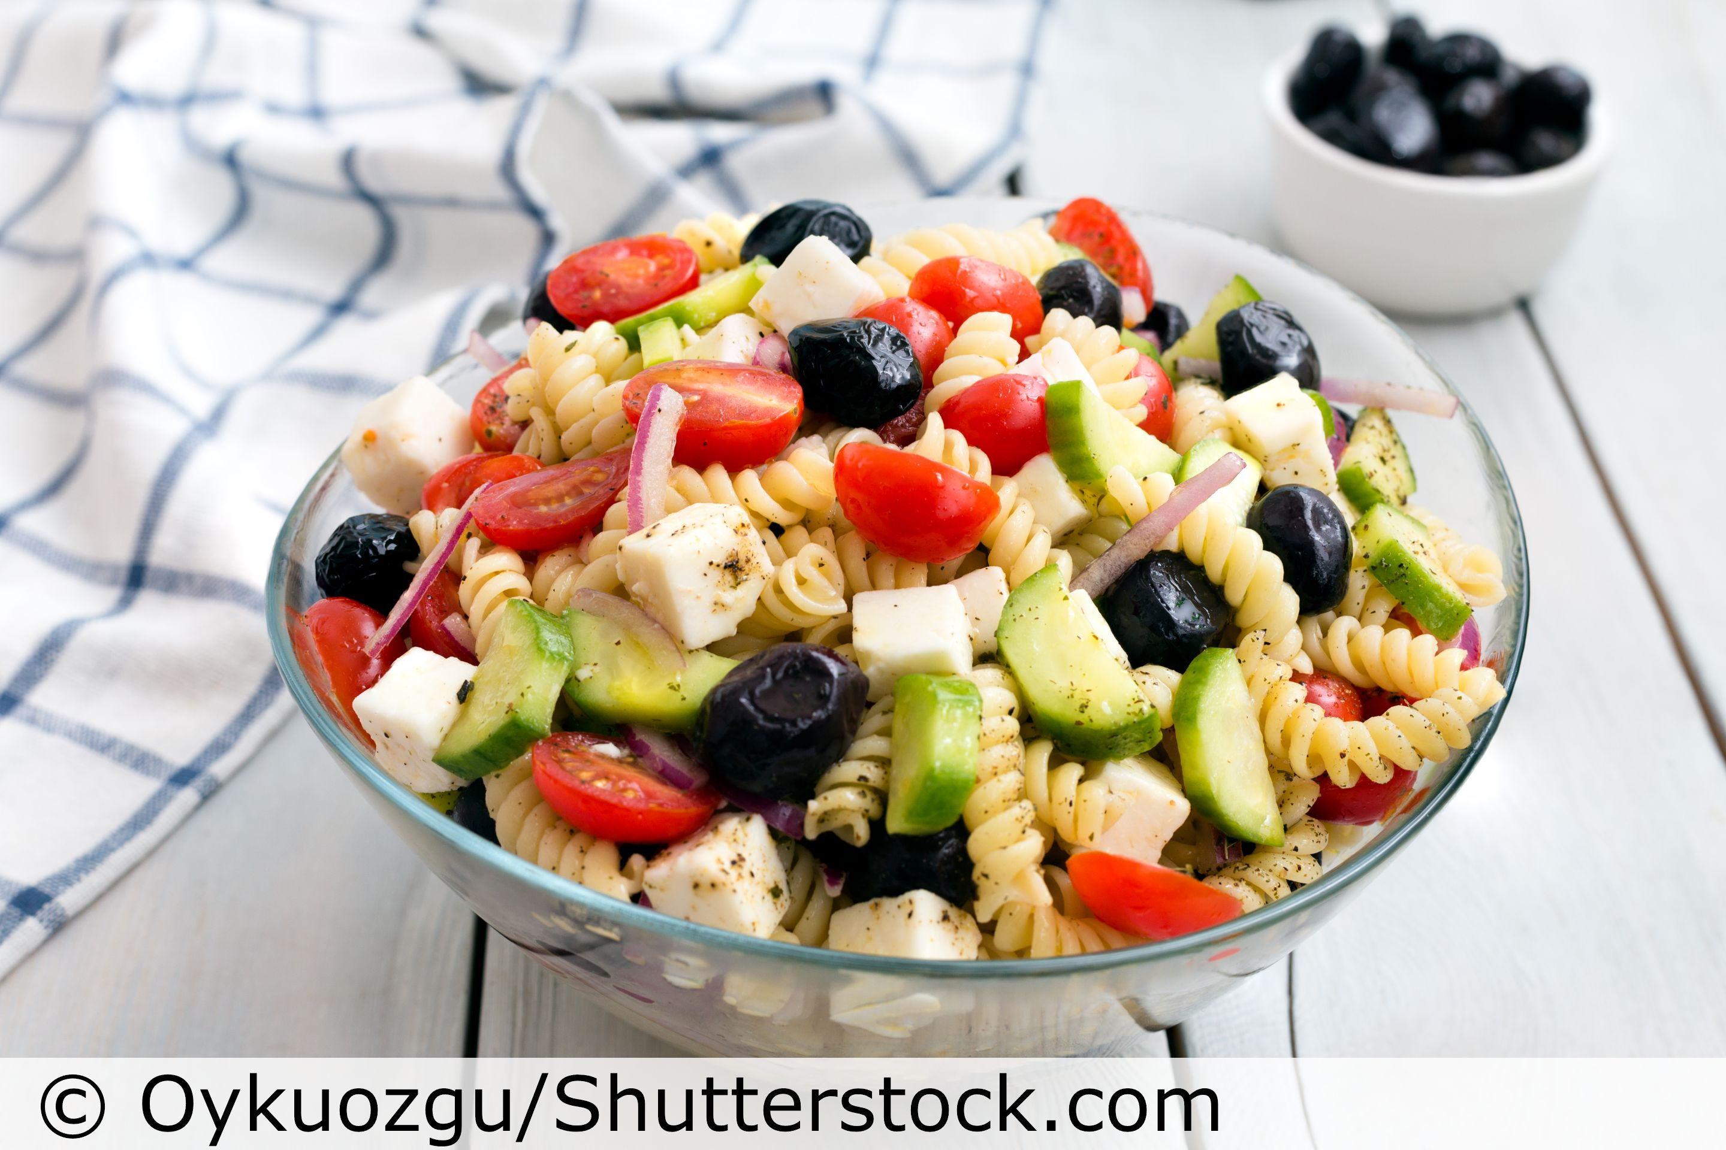
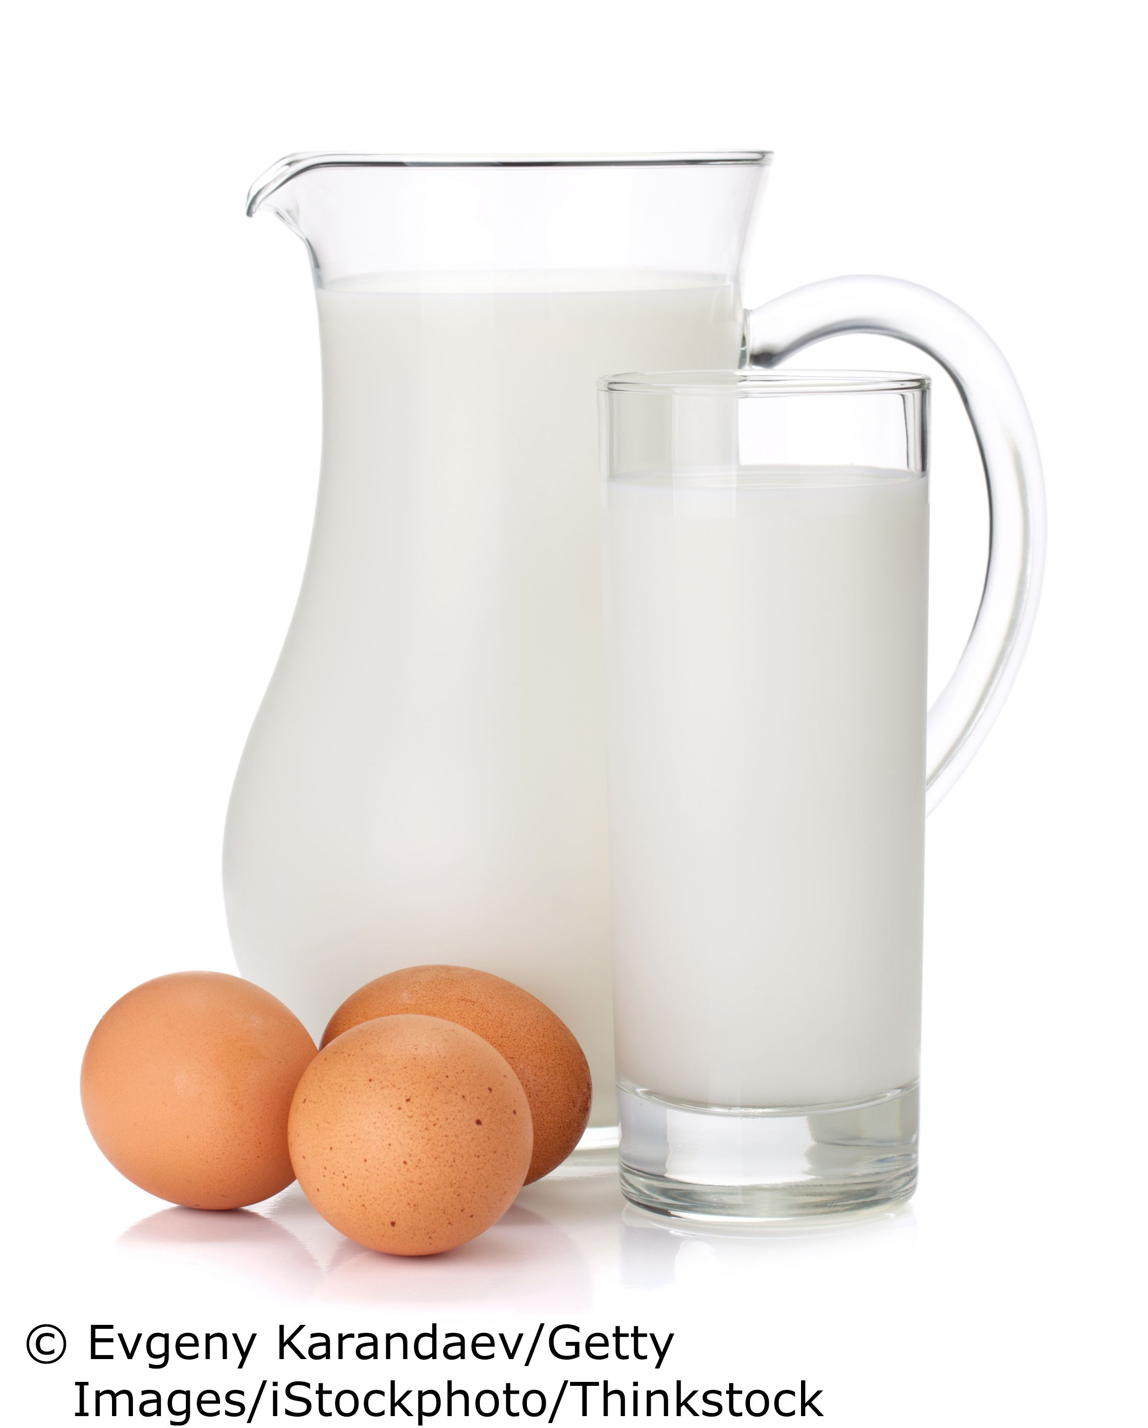
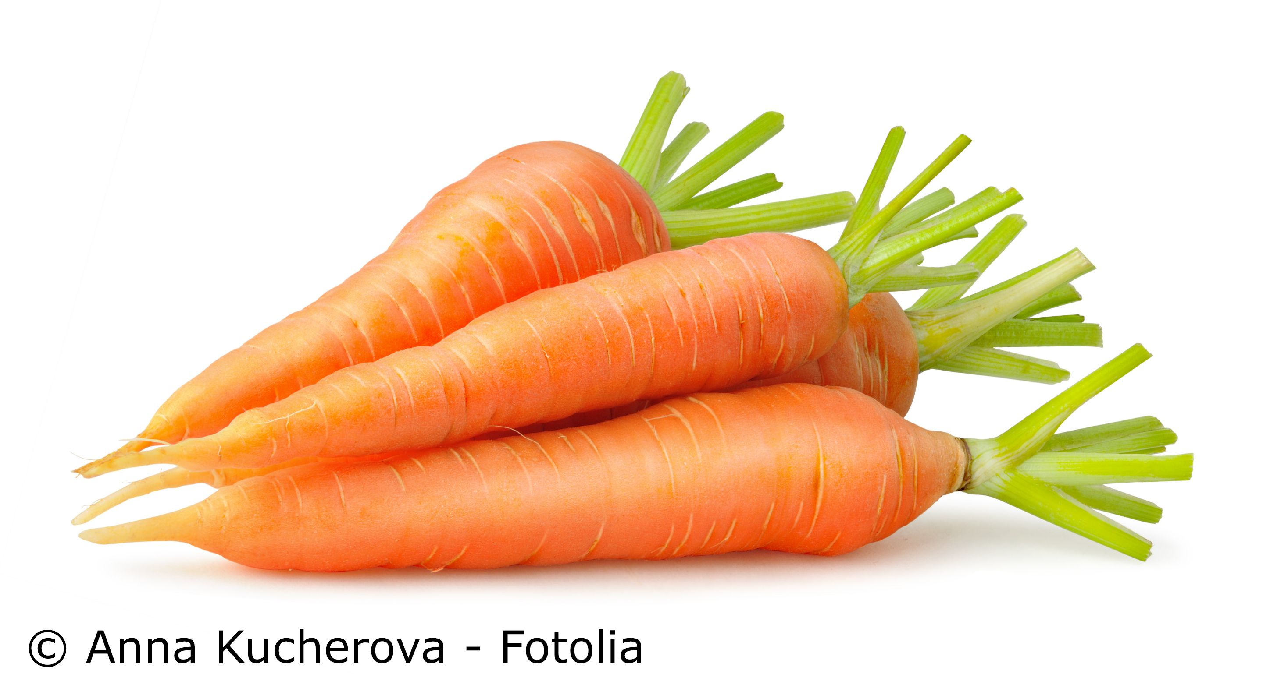
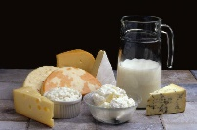

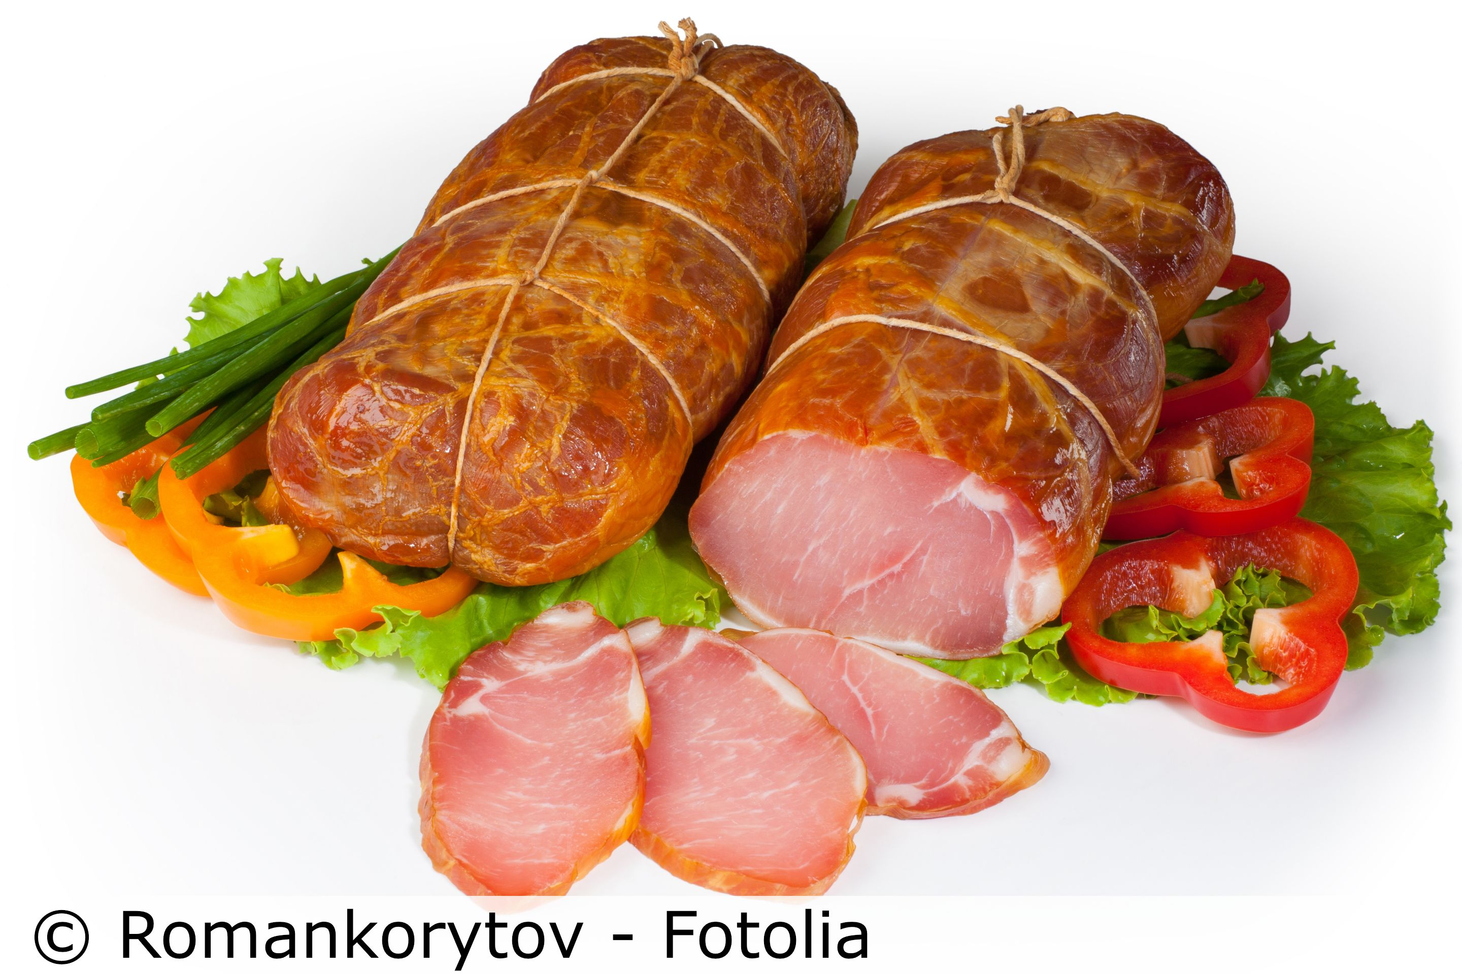
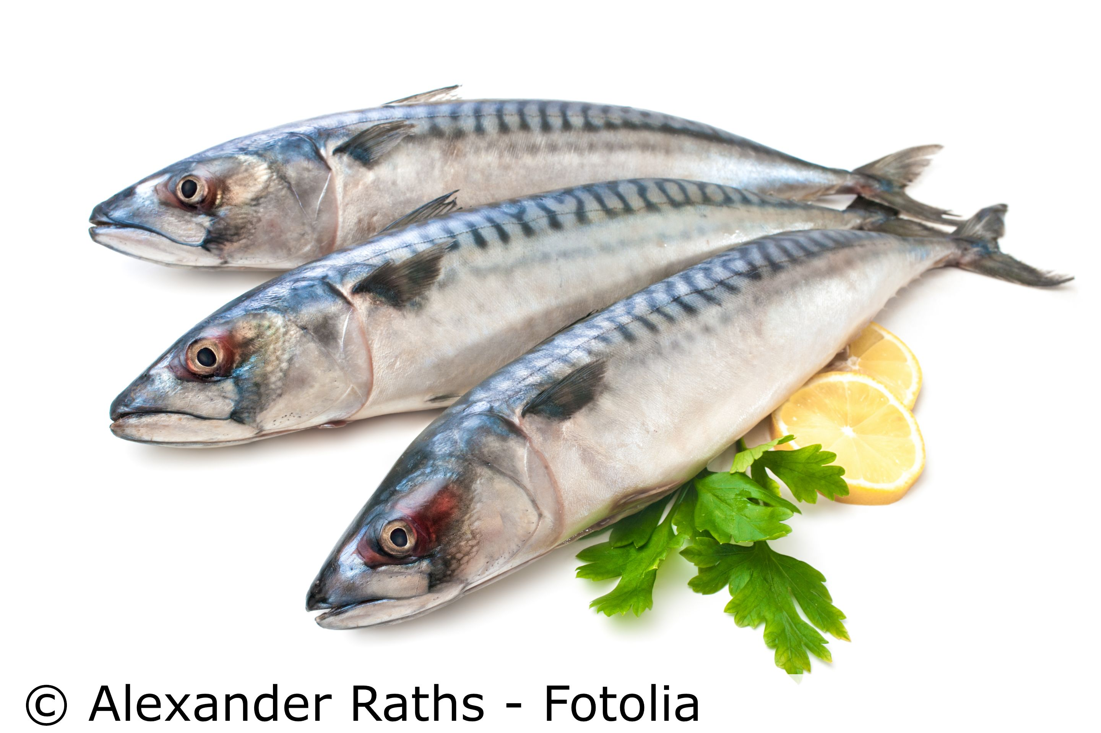
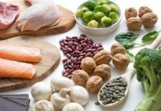
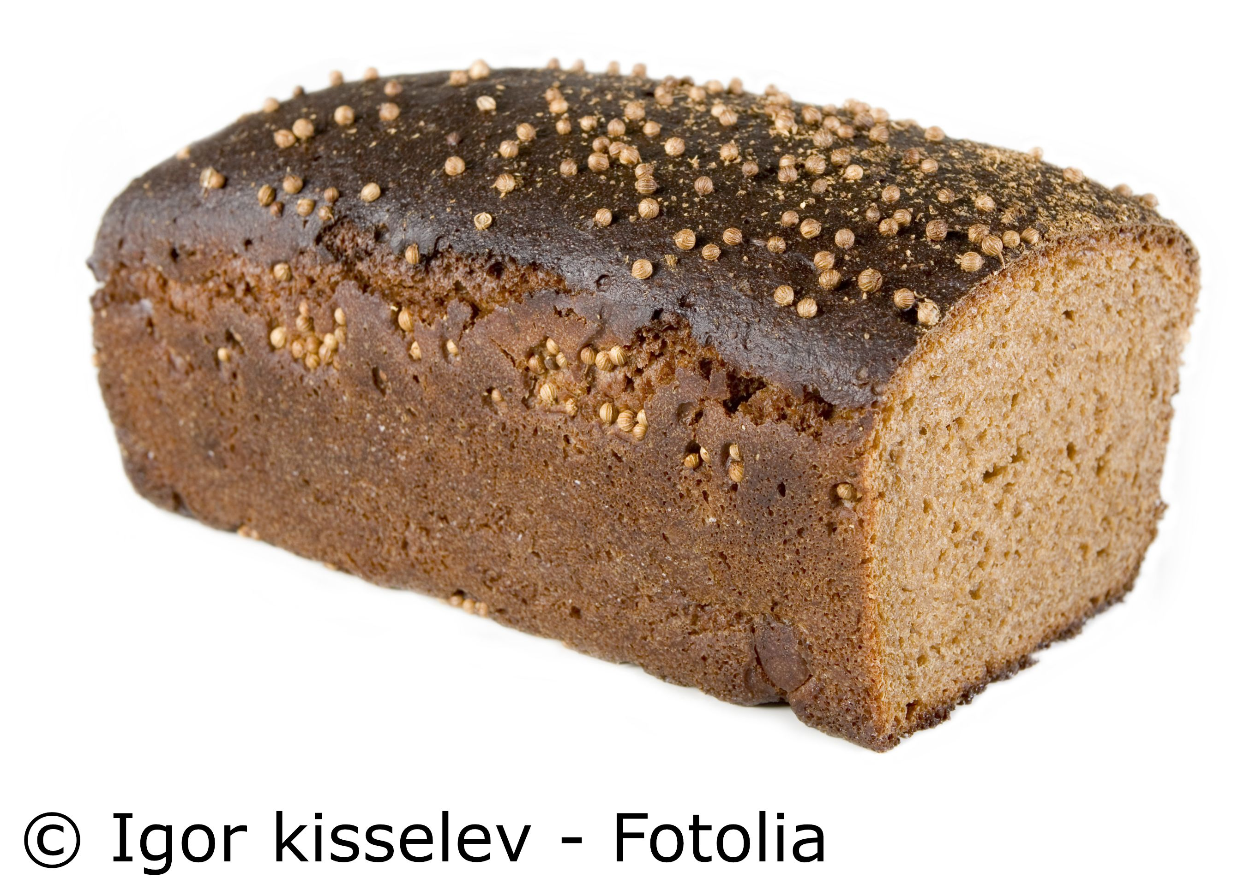
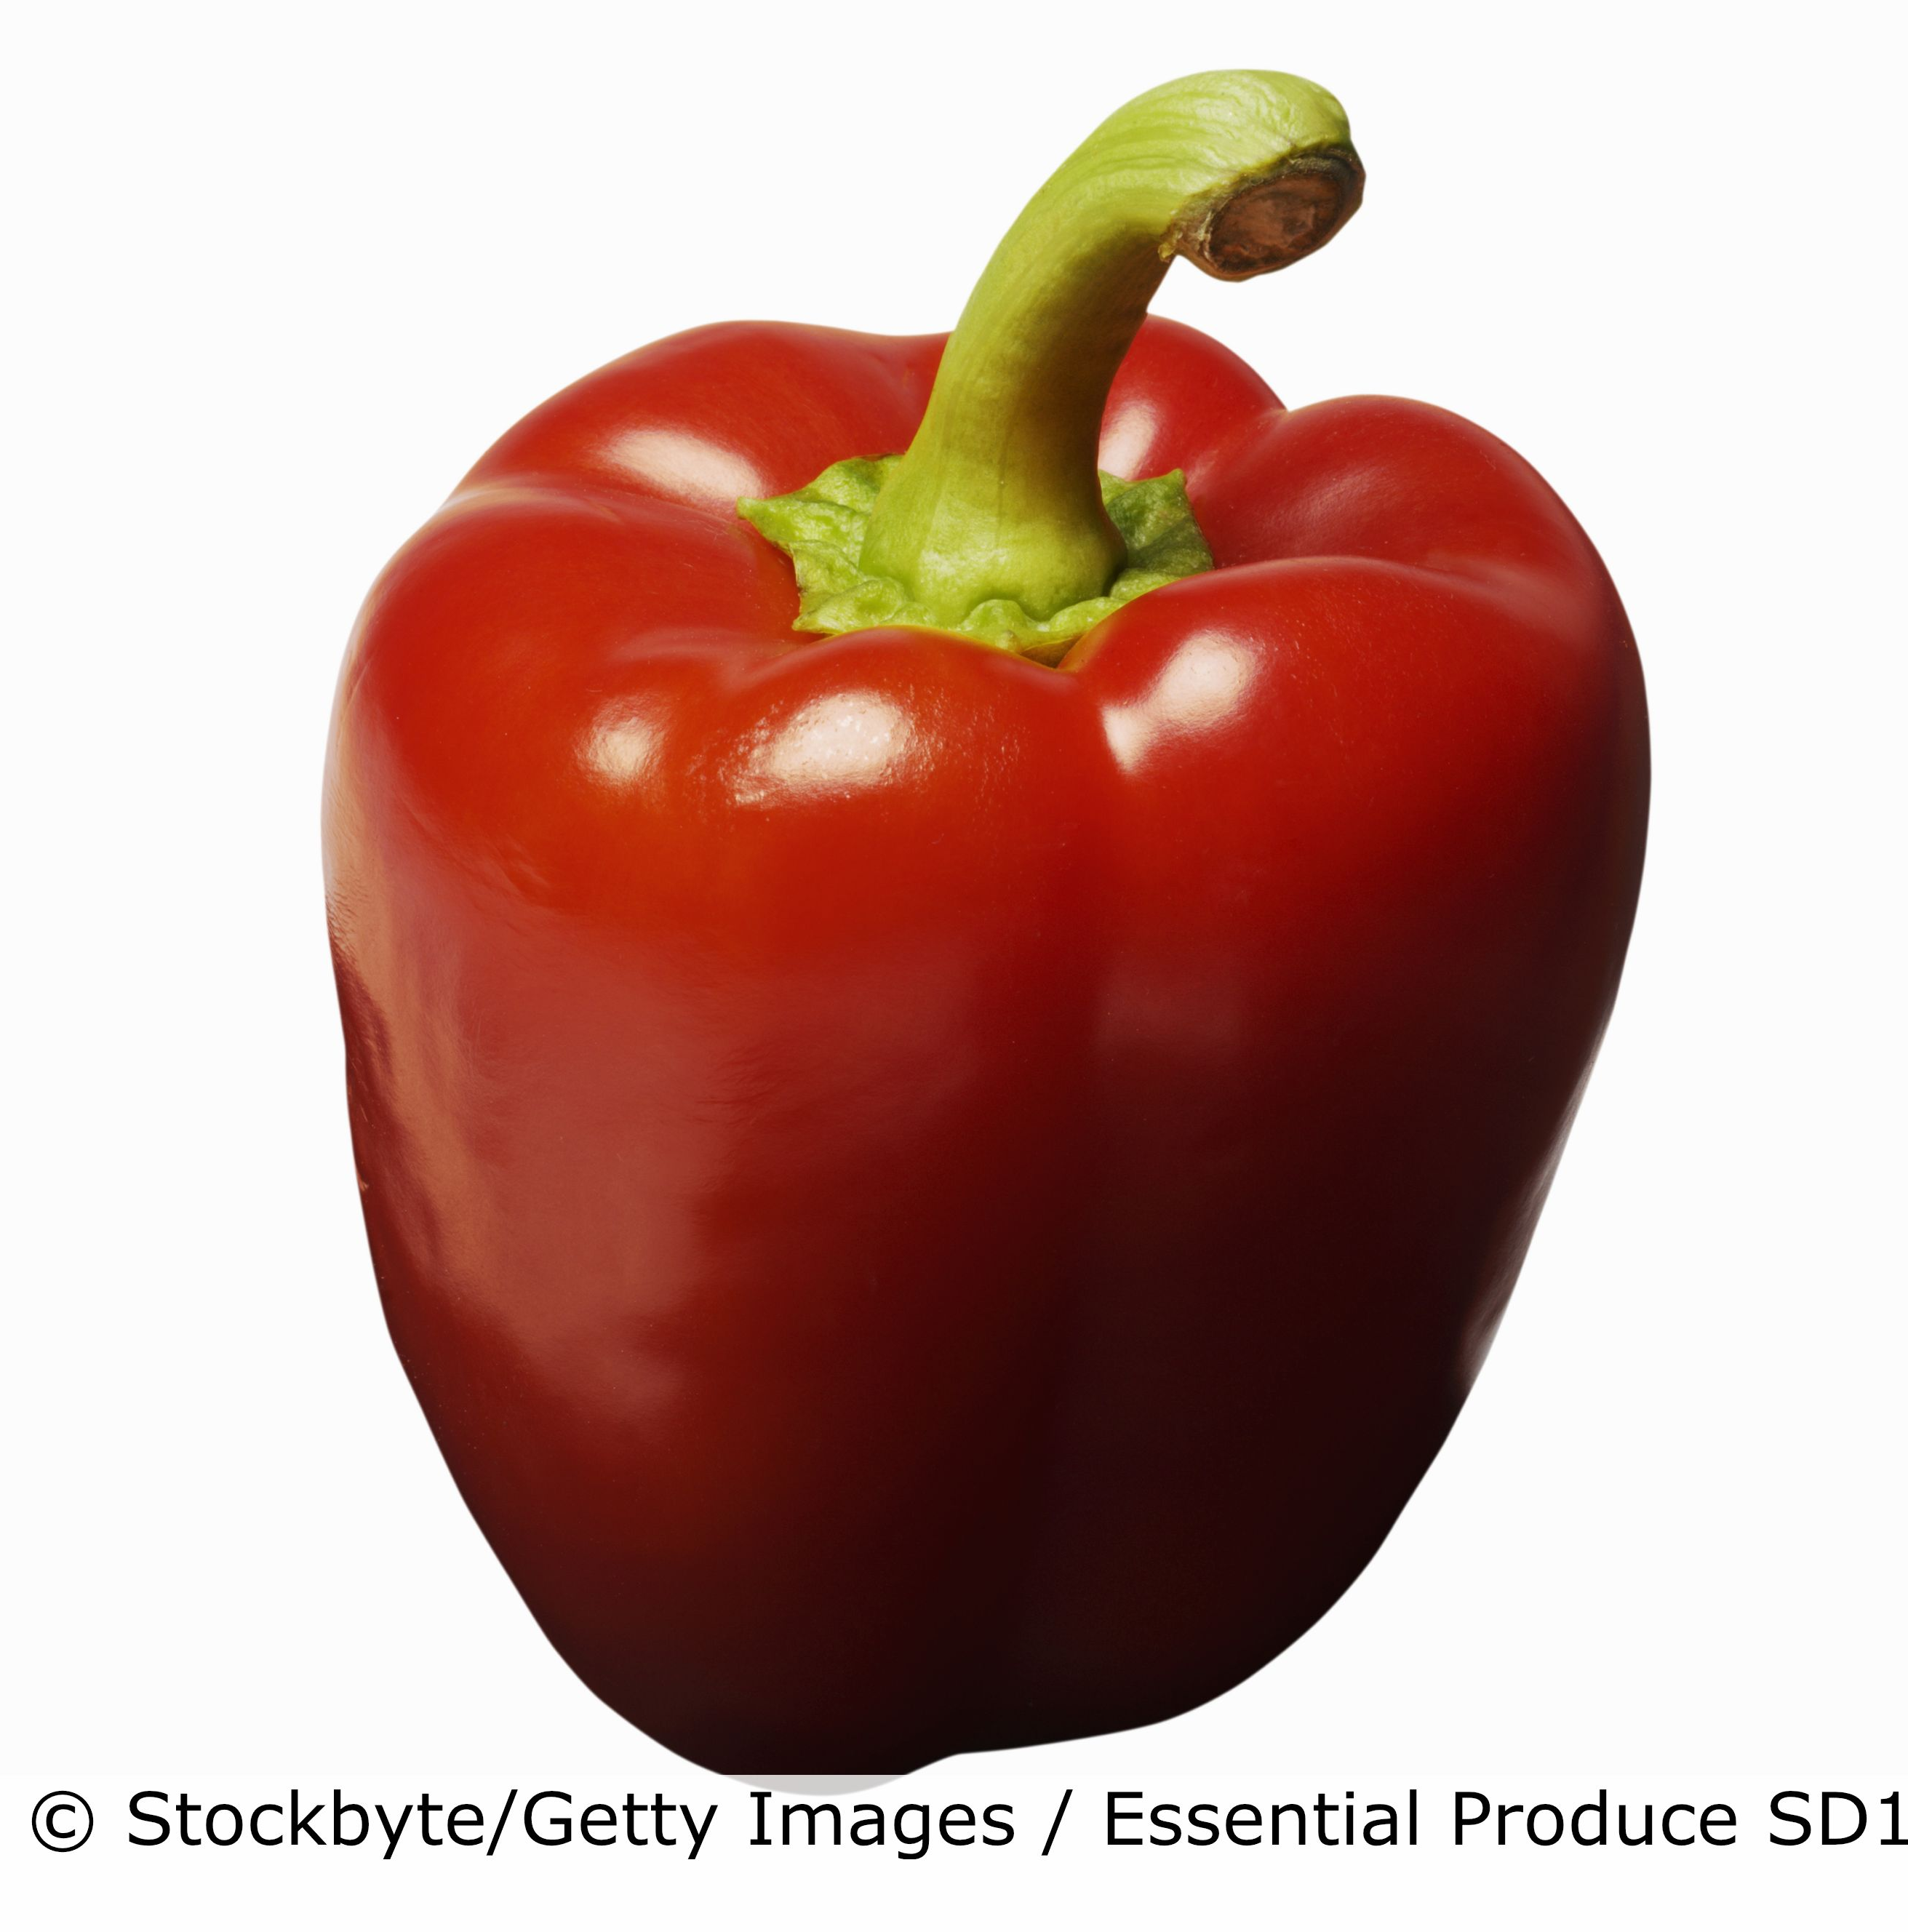
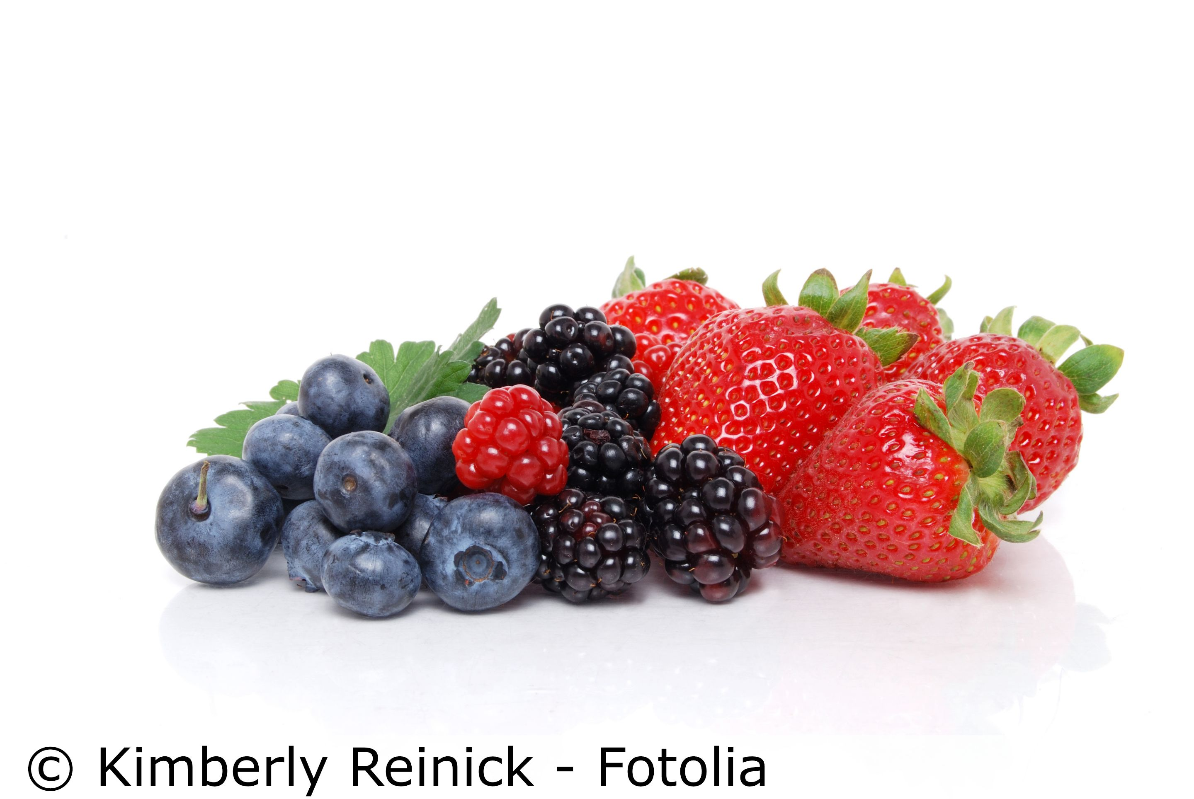
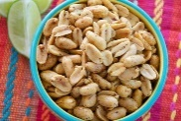
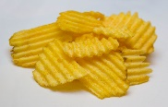
Year 8 - Why do I need to eat food? Page 1
Nutrient | Food source | Main functions | Picture
Protein | Beans and pulses, Fish, Eggs, Chicken, Meat, fish | Growth and repair of cells, Repair, Energy | Soya beans are high in protein
Knowledge - Nutrients
The body needs food (nutrients) for the growth and repair of cells, for energy, warmth, protection from illness and keeping the body working properly. A variety of food is needed to ensure the body has all the nutrients it requires.
Fat | Vegetable oils, Butter, Lard, Margarine, Fat spreads | Keeps the body warm, Provides energy, Protects organs | Fats and oils
MACRONUTRIENTS—needed in large quantities. (grams)
MICRONUTRIENTS—needed in small quantities , (micrograms)
Carbohydrate | Starch | Potatoes, Rice, Pasta, Bread | Starch provides slow-release energy | Foods high in starch
 | Sugar | Sugars and syrups, honey, fruit juice | Sugar provides fast-release energy | Foods high in sugar
 | Fibre | Wholegrain cereals Fruit and vegetables | Fibre keeps the digestive system healthy | A food high in fibre
Vitamins | Food source | Main functions | Picture
A | Liver, carrots, milk, eggs and bread | To improve vision, especially at night. For healthy skin.
Minerals | Food source | Main functions | Picture
Calcium | Yoghurt, milk, cheese, tofu | Build strong bones and teeth.
Iron | Dark green vegetables, beans, fish, egg yolk, red meat | Keeps red blood cells healthy
Sodium (salt) | Cheese, ready meals, salted nuts, bacon | Keeps the correct water balance in the body
B group | Milk, cheese, meat, breakfast cereals, bread and fish | Helps the body release energy from the food you eat.
C | Berries, oranges, broccoli, red and green peppers | Helps wounds heal. Helps the body to absorb iron.
Self Assessment:
Why do some people need more protein than others?
Which 2 plant foods are high biological value?
Describe the difference between fat and oil.
What happens if too much carbohydrate eaten?
How much fibre should adults each eat day?
What is the main function of the B group vitamins?
Name 3 foods high in iron
In Practice:
Plant proteins are popular.
Plan and make-
hummus and pitta bread
a recipe using mycoprotein
D | Milk, butter, oily fish, eggs and mushrooms | Strong bones.

Slide 6
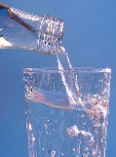
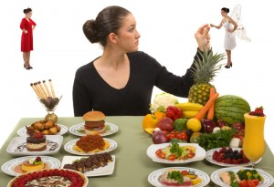
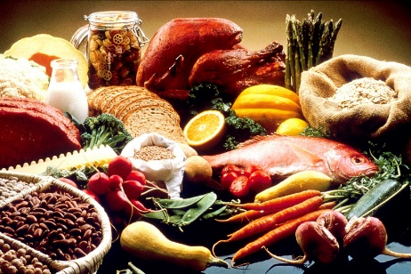
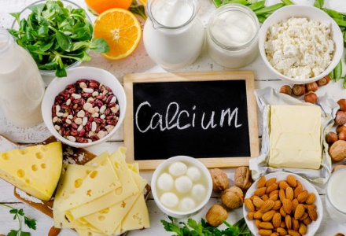
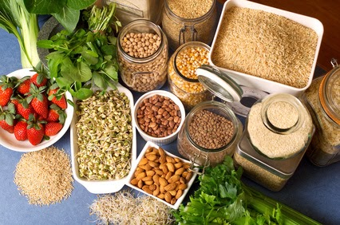

Year 8 - Why do I need to eat food? Page 2
Water
Dehydrated? Thirst, headache
6—8 glasses a day
Helps with transporting
nutrients, removing waste, regulating body temp
Knowledge – Key vocabulary
Nutrients – the components which make up food
Maintenance – to keep something working
Diet – the foods you choose to eat
Balanced Diet – a diet that contains all the nutrients in the correct amounts
Healthy Diet – a diet that is LOW in fat, salt and sugar and HIGH in fibre
Malnutrition- caused by a lack of nutrients in the diet
Deficiency- a lack of a particular nutrient in the diet
Energy Needs – the average amount of food energy needed by individuals, usually measured in kilocalories (kcal)
Absorb – the nutrients are taken into the body (absorbed) and are mainly carried off in the blood stream
to other parts of the body for storage or further chemical change.
Macronutrients- nutrients needed by the body in large amounts. They are fats and oils, carbohydrates & proteins
Micronutrients - nutrients needed by the body in smaller amounts. They are Vitamins and Minerals
Amino Acids – the building blocks of protein
Essential Amino Acids – amino acids that your body needs and cannot make by itself, they come from your diet
Non-essential Amino Acids – amino acids that your body can make by itself
High Biological Value (HBV) – protein foods that contain all the essential amino acids
Low Biological Value (LBV) – protein foods that are missing one or more essential amino acids
Protein Complementation – when two LBV protein foods are combined to form HBV protein
Sugar – simple sugars (eg glucose) and double sugars (eg sucrose)
Starch – a complex sugar ( eg potatoes, rice and bread are high in starch)
Saturated Fats – usually from animal sources; can be harmful to health
Unsaturated Fats– usually from plant sources; can be good for health
Cholesterol – a fatty substance which is needed for the normal functioning of the body
Fat Soluble Vitamins - Vitamins A D E & K
Water soluble vitamins – B group vitamins ,
vitamin C
Minerals – eg calcium, iron, sodium chloride
Sodium Chloride (salt)- linked to strokes and heart attacks
Dietary fibre (NSP) – a complex sugar found in the cell walls of plants (fruits, vegetables, pulses and grains). Helps the digestions of food and remove waste (NSP –Non Starch Polysaccharide)
Digestive system – parts of the body where food is broken down to provide nutrients
Constipation – when stools are dry and hard to pass,
Type 2 Diabetes – a condition where the body’s sugar levels cannot be controlled properly
Heart Disease (CHD) – a build-up of fatty deposits in the coronary arteries (CHD- Coronary heart disease)
Obesity – being very overweight, carrying more body fat than is healthy.
Anaemia- Too few red blood cells caused by a lack of iron in the diet.
Bowel Cancer- Can be prevented by eating dietary fibre
.
Osteoporosis- brittle bone disease caused by a lack of calcium.
Tooth decay- caused by plaque and too much sugar eaten.
Unhealthy v Healthy food choices
Protein
Calcium
Dietary fibre (NSP)
Iron
Assessment activity:
Research into a specific nutrient. Plan and make a food product containing a good supply of the nutrient.
Carry out a nutritional analysis of the food product.
Comment on the results and suggest changes you could make to alter the nutritional content

Slide 7


























Year 8 Extension–Food Provenance
Food Provenance- knowing where food is grown, reared, caught and how it is produced and transported.
Food Miles - The distance food travels from Farm To Fork
Where does our food come from,
how is it produced and why do we need to know?
Red Tractor is a food assurance scheme showing the food has been farmed, processed and packed in the UK. It is traceable, safe to eat and has been produced responsibly.
Foods:
Milk, cheese, yoghurt, poultry
Locally Sourced Foods – A way of reducing food miles is to buy locally sourced foods, these are also seasonal and can sometimes be organic too.
The animals have access to outdoor space and can live naturally. The welfare standards are high.
Foods:
Eggs, meat
Local and Seasonal Foods
Seasonal Foods - Foods that are harvested and eaten in the season they are naturally ready to eat.
Foods that have this label mean the animals have had a good life and have been treated with respect
Foods:
Eggs, meat & fish
Most UK-grown fruit and vegetables are not available all year round.
This means the food has been produced without using any chemicals. Only natural fertilisers and pesticides are used to help the crops grow.
Foods:
Eggs, chicken, fruit and vegetables
The farmer gets a fair price for his produce and fair working and living conditions.
Foods:
Sugar, bananas, coffee, tea
Using sustainable methods of fishing to prevent the decline in number of fish in our seas.
Spring
http://eatseasonably.co.uk/what-to-eat-now/calendar/
Foods:
Fish, seafood
Summer
Autumn
Winter

