Slide 1

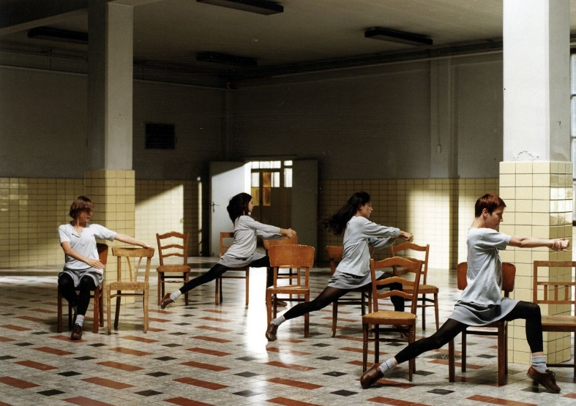

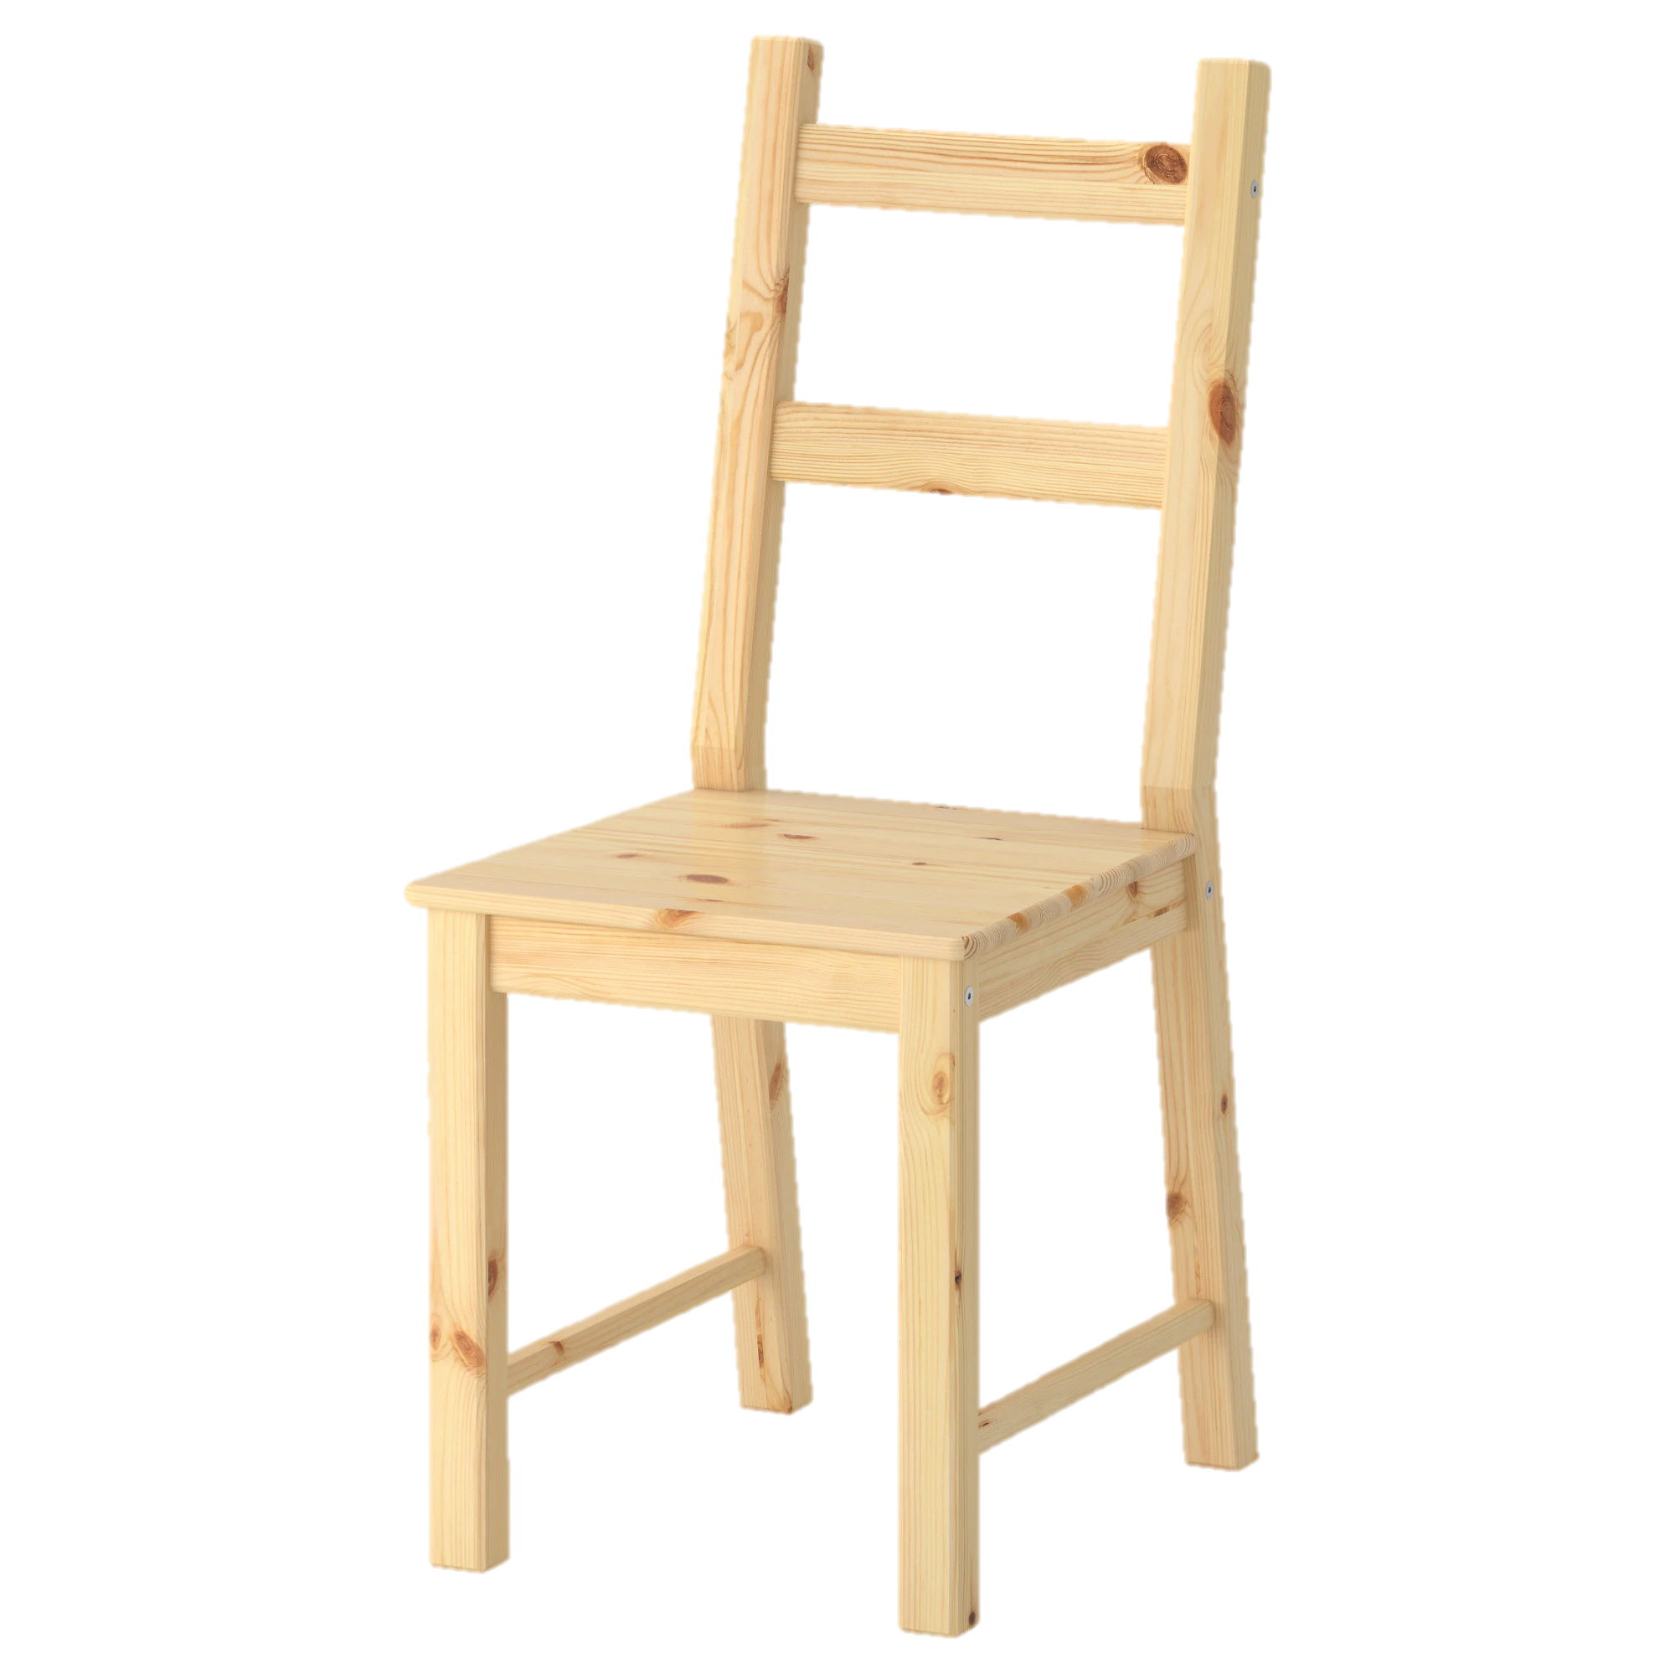
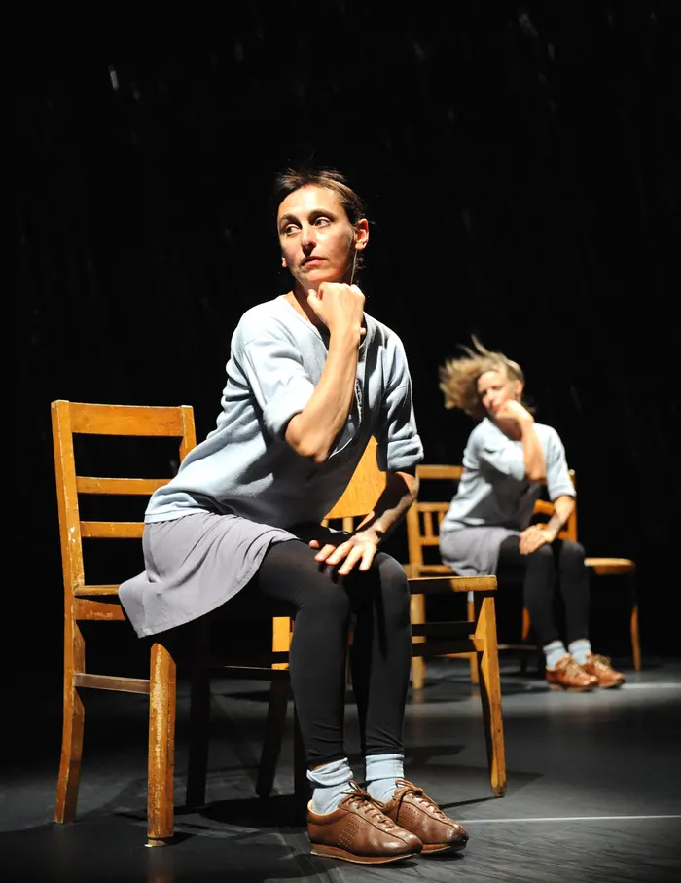

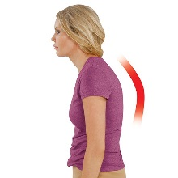





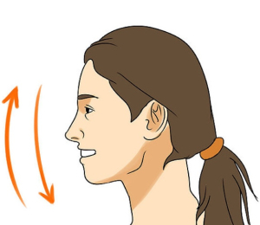
"Riveting and exhausting, fascinating and relentless…”
Key Information
Choreographed by Anne Teresa De Keersmaeker
First performed in 1983
Film was created and performed in 1997
Nationality, Belgium.
Her dance company is called ‘Rosas’
Rosas Danst Rosas was the companies first piece
Rosas Danst Rosas means “we dance ourselves”
Dance style is ‘Contemporary’ dance.
UNIT 3 – Professional Dance Study
‘Rosas Danst Rosas’
Floor sequence
Themes – Human behaviour and rage.
5 Basic Dance Actions
On your tummy, cobra.
Look to the right.
Feed left arm through.
Roll to the left, end back on tummy.
TRAVEL
TURN
JUMP
BALANCE/STILNESS
GESTURE
Dance styles – Pedestrian, minimalist, gestural, abstract, mechanical, grounded.
The dance is structured around the phases of a day. The first movement represents the night-time, the second is the morning, the third is afternoon and the fourth movement, the dancers go into a kind of overdrive.
Motif Development: Working with existing movement material and changing it to create a new section of your dance.
First 8 Counts
Retrograde – perform your sequence backwards.
Change the levels – if you raised your arm up, take it down etc.
Add an action
Take an action away
Repetition – repeat an action
1. Twiddle your fingers on your lap.
2. Cross your right leg over the left.
3. Nod your head.
4. Cross your arms.
5. Slouch.
6. Sit up.
7. Arm up.
8. Arm down.
Most common used choreographic device in this piece.

