Slide 1
Year 7
Knowledge Organisers

Slide 2
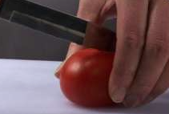
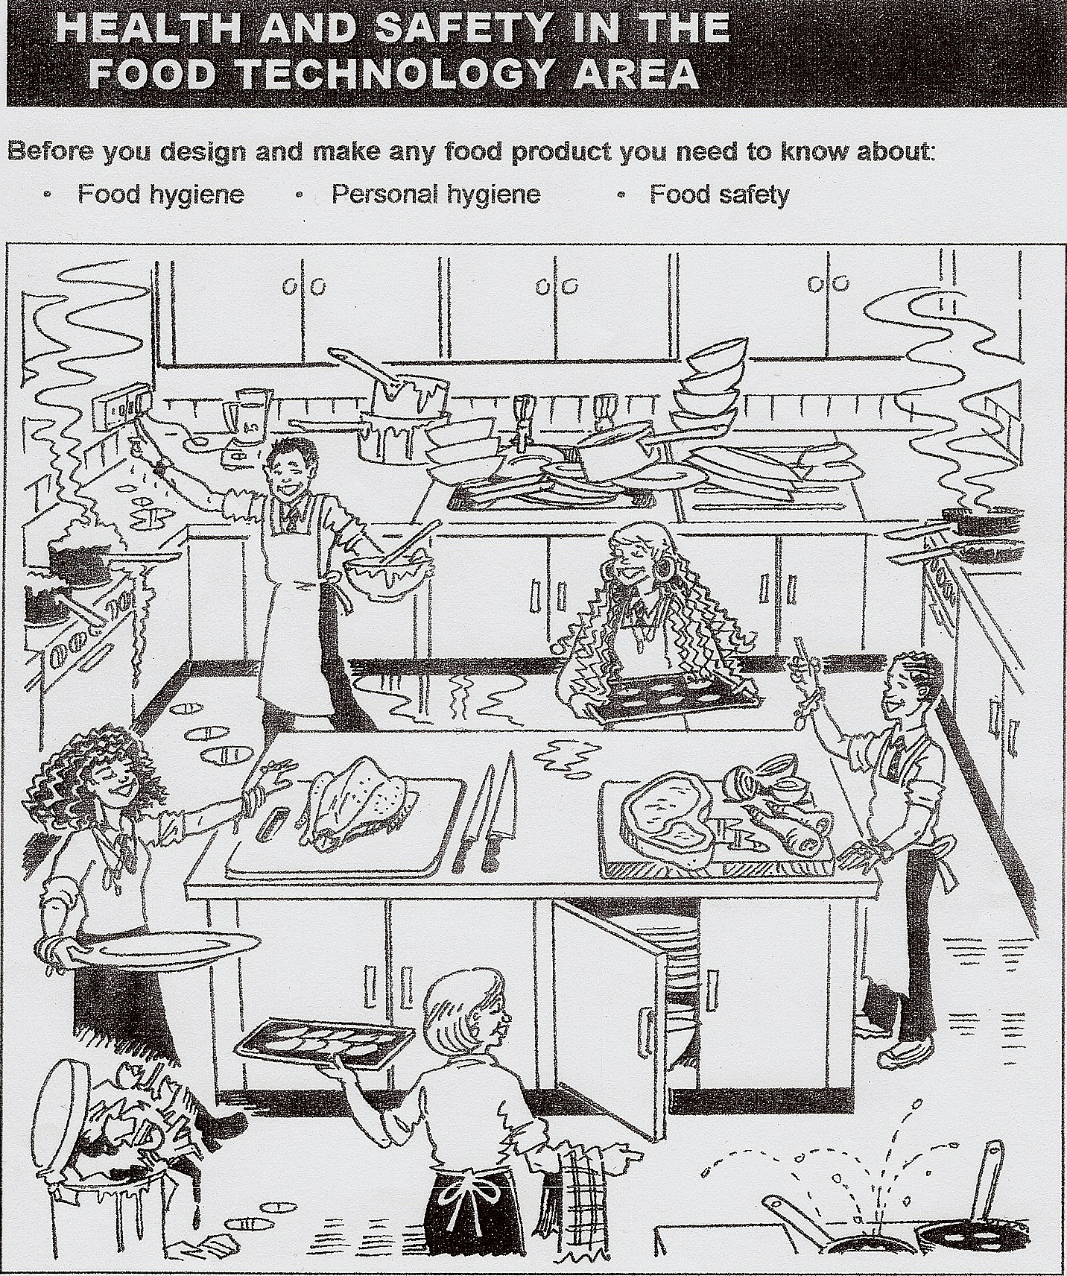
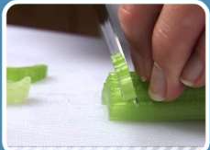

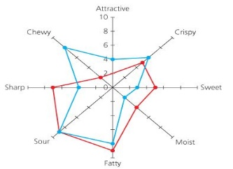

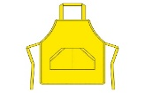

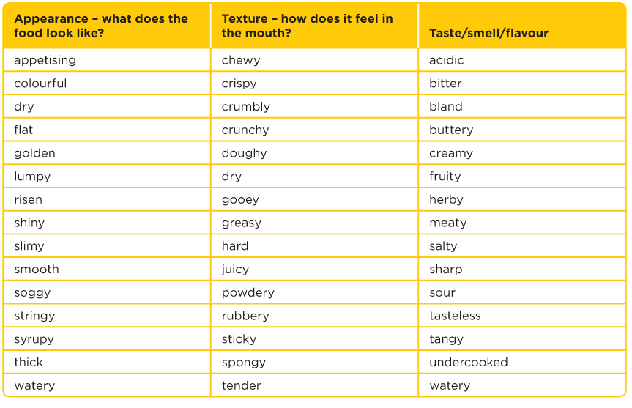
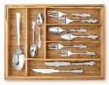

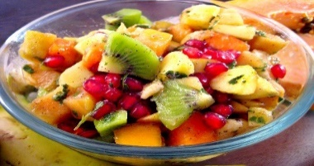

Year 7 - Why are there so many rules in the Food room?
Follow a process plan to make a fruit salad
Explain the hygiene and safety hazards in this kitchen.
Teacher Assessment:
Can you follow the rules to ‘plan, make and evaluate’ a Fruit Salad product.
WWW Cooking and Nutrition
Can follow health and safety practices
Can use knives safely
Can follow a process plan to make a ____________
WWW Evaluating
Can judge the sensory characteristics of a food product
Can suggest how the food product can be improved
Plan the making of a quality food product
Product Name: | Fruit Salad
Ingredients: List the ingredients to be used | Equipment: List the equipment To be used
Process of Making: Include a step by step instructions on how to make your food product Organise self, unit and washing up area. Place ingredients on tray. Include the use of key words –bridge claw dice slice chop shred grate combine
Claw grip
Following ‘Health and Safety’ practices -
Bridge hold
Personal Hygiene is about caring for your body by keeping
it clean and healthy.
Food Hygiene refers to the rules followed when handling,
cooking and storing food to prevent food poisoning.
Use the 4c’s: prevent cross contamination
cleaning
chilling
cooking
Using knives safely and general practical skills-
Food Skills | Techniques
Knife skills -chopping | Bridge hold, claw grip, slice, dice, julienne, baton, meat and vegetable preparation
Organisation / tidying skills | Being able to work hygienically and safely to make food products and ensure all equipment, utensils and work area is left clean and tidy. Follow personal hygiene rules.
Food Safety | Ensure food is stored appropriately and food probes used to check for safe temperatures.
Weighing and measuring | Demonstrating accurate measurements of liquids and solids.
Use of equipment | Oven, hob, knives, chopping boards, sieve, mixing bowl, measuring jug, spoons. Electric hand equipment eg food mixer
Judge and manipulate sensory properties | Demonstrate how to taste and season during cooking. Self evaluation of food products.
Evaluate the food product using sensory descriptors
Evaluate the product using a Star Profile – These are used to obtain a detailed description of appearance, taste and texture of a food product. Qualities such as mouthfeel, appearance, aroma, flavour and texture are assessed. The results of the profiling test are plotted on a star diagram. This is called a Star Profile
Design a poster to
encourage people
to follow the 4C’s.
What is sensory evaluation?
When you eat food you are judging its following characteristics:
Appearance, taste, aroma (smell) and texture (mouth feel).
Sensory descriptors are words used to describe the characteristics.
Health safety and hygiene
Tie hair back. Tuck head scarf in. Wash hands before preparing any food, after handling raw meat, after sneezing/coughing and after going to the toilet.
Collect a clean apron, tea towel and dish cloth
Clean your table/ work surface with antibacterial spray. Prepare your sink and work area.
Collect a cutlery and food tray
Collect your ingredients
Collect and prepare equipment

Slide 3
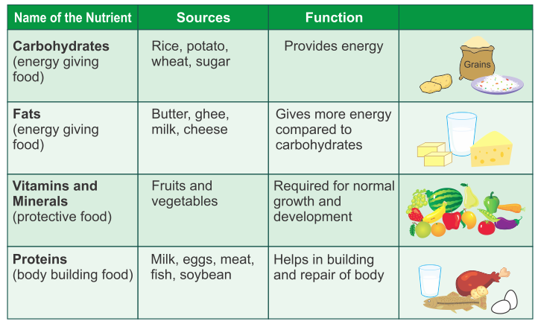
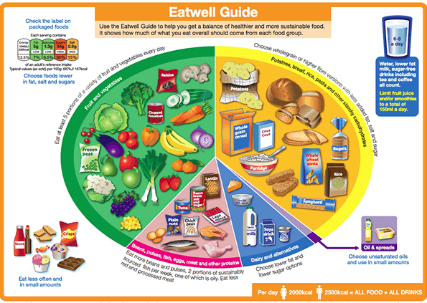
Year 7 - Why does it matter what I eat?
Self Assessment:
Can you name the missing nutrients:
? Is needed for growth and repair of cells. ? and ? are needed for energy. ? are needed for insulation. ? and ? are needed for protection.
Describe the eatwell guide?
Why is 150ml of fruit juice and smoothies the maximum recommended in one day?
In Practice:
Make a packed lunch which shows balanced and healthy choices following the healthy eating guidelines or a fruit crumble using high-fibre ingredients
The body needs food for the growth and repair of cells, for energy, warmth, protection from illness and keeping the body working properly
A healthy diet is a diet that is low in fat, salt, sugar and high in fibre.
A balanced diet is a diet that contains all the nutrients in the correct amounts. Nutrients are the components which make up food
The Eatwell guide shows how eating different foods can make
a healthy and balanced diet.
A traffic light food label is colour-coded and helps you choose healthy foods.
We should drink 6-8 cups a day, drinks include
Water
Lower-fat milk
Sugar-free drinks
Tea and coffee
Fruit juices and smoothies are high n sugar: a maximum of 150ml per day
is recommended
Knowledge - Nutrients
Knowledge - EWG
A traffic light food label is included so that you can recognise this label and know that the green labels are the healthiest choices.
5 a Day – Fruits & Vegetables
Eat at least 5 portions of a variety of fruit vegetables every day.
An adult portion is 80g but children need smaller portion sizes. 1 portion is
roughly the amount you can fit in the palm of your hand.
Eat as many different colours as possible because they all contain
different combinations of fibre, vitamins, minerals and other nutrients.
Find out more: www.nhs.uk/live-well/eat-well/why-5-a-day
Foods high in fat and sugar have been removed from the main segments as these should be eaten less and in small amounts
The average energy needs of men and women are included, to remind you that all food and drinks contain energy

Slide 4
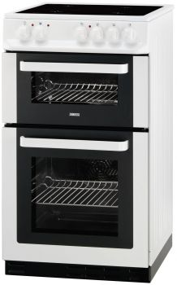
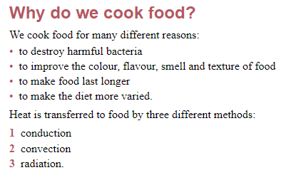
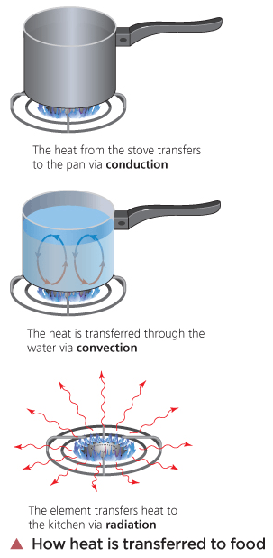
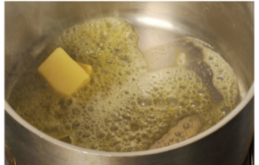
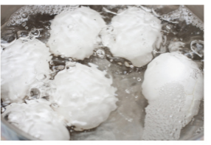
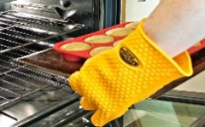
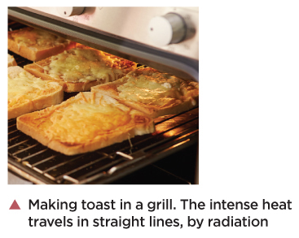
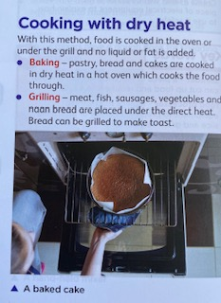
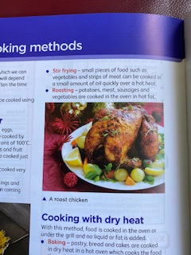
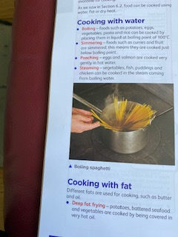
Year 7 – Why do I cook food?
Knowledge –Cooking food - Why and How?
Self Assessment - Can you:
Explain 3 reasons why we cook food.
Name 4 foods which can be grilled?
Name 4 foods which can be cooked on the hob?
Name 4 foods which can be cooked in the oven?
In Practice
You will make the following food products in school. Which methods of heat transfer are used?
PizzaToast
Cheese and Potato Pie
Muffins
Using the Cooker
A cooker is made up of 3 parts- the hob, the grill and the oven.
It is important to consider safety points when using a cooker
Pan handles should be placed inwards on the hob
The grill should be left open when in use
Oven gloves should be used to put food in the oven and take it out
Hob
With fat –melting butter
Grill
Oven
With water –poaching eggs
Dry heat -grilling
Conduction – heat transfers through solid and liquid materials
Convection – heat travels through hot water
Radiation – heat rays directly heat food
Cooking Methods
Cooking with dry heat
Baking | Cooked in the dry heat of the oven
Grilling | Cooked by the radiant heat of a hot grill. Direct heat.
Cooking with fat
Stir Fry | Cooked quickly over intense heat in a wok with little oil
Shallow Frying | Cooked in a shallow pan with hot fat
Deep Frying | Cooked submerged in very hot oil
Roasting | Cooked in the dry heat of the oven and basted with hot fat
Cooking with water
Boiling | Cooked quickly in boiling water – 100C
Poaching | Cooked in gentle simmering water – below boiling point
Dry heat -Baking a cake
With fat – Roast Dinner
With water – Boiling pasta

Slide 5
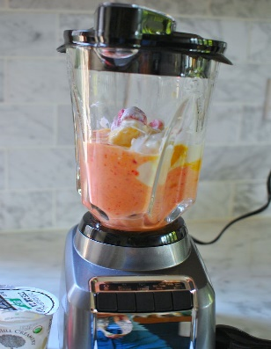
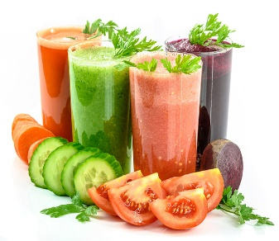
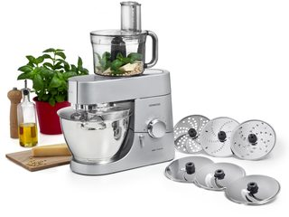
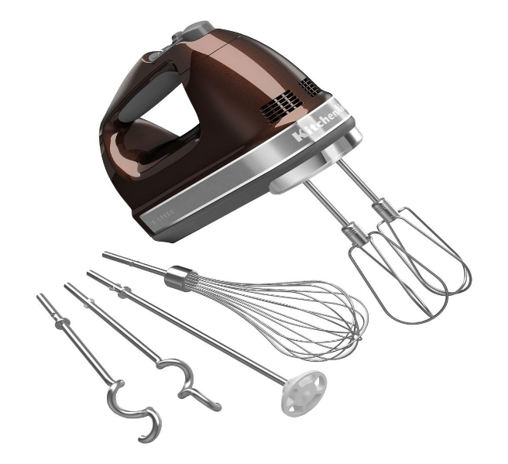
Year 7 – Can I use electric equipment?
Knowledge –Electrical equipment - Why and How?
Using equipment safely
Do not use electrical equipment when your hands are wet
Do not put the electrical equipment in water to wash it up
Switch off at the socket when you have finished using electrical items
Wash equipment carefully- If the equipment is sharp, do not place it in
a bowl of soapy water where it cannot be seen.
Do not use metal spoons in a saucepan, as they conduct heat.
Electrical equipment
Used to save human energy and time.
A blender saves time when crushing fruit and vegetables to makes soups and smoothies
A food processor has attachments that can prepare a variety of foods.
It is useful for cutting and shredding large quantities of vegetables.
It is very quick and can save time.
The main uses of a food processor are to chop, make dough such as pastry or pasta, liquidise, puree, grate and slice.
Hand-held mixers mix, whisk, knead or beat
Small quantities of food.
Electric mixers are much quicker than mixing by hand, and can be used in any bowl or container.
Mixers are used to whisk cream, and to whisk egg whites to make meringue.
They can be used to beat mixtures such as cakes
Some mixers have a dough hook for kneading bread dough
Self Assessment –
Which piece of equipment will you use for the following food tasks:
In Practice:
Make a dish which uses a piece of electrical equipment
Food processor – Coleslaw
Hand-held mixer – banana cake
Blender – a smoothie
Food Task | Piece of equipment
Chopping nuts
Making shortcrust pastry
Making a Victoria sandwich cake
Making a fruit smoothie
Blending soup
Whipping cream
Shredding cabbage and grating carrots for a coleslaw

Slide 6
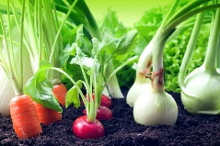
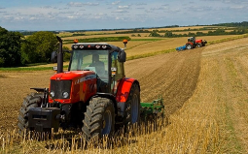


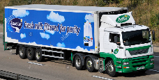






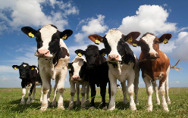
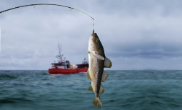

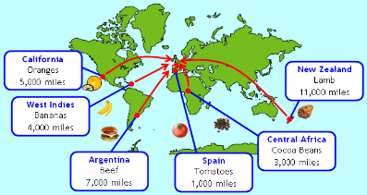

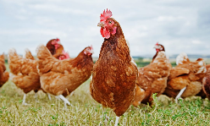
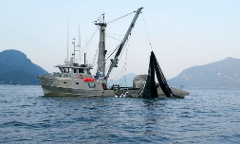


Year 7 Extension –Food Provenance
Food Provenance- knowing where food is grown, reared, caught and how it is produced and transported.
Food miles - The distance food travels from Farm To Fork
Grown
Some comes by lorry from all over the UK or Europe
Some is local
Where does our food come from?
All our food comes from plants and animals
Food miles
How far does our food travel to get to us?
Reared
Caught
Some is flown here from all over the world
The higher the food miles the bigger the environmental issues for our planet

