Slide 1







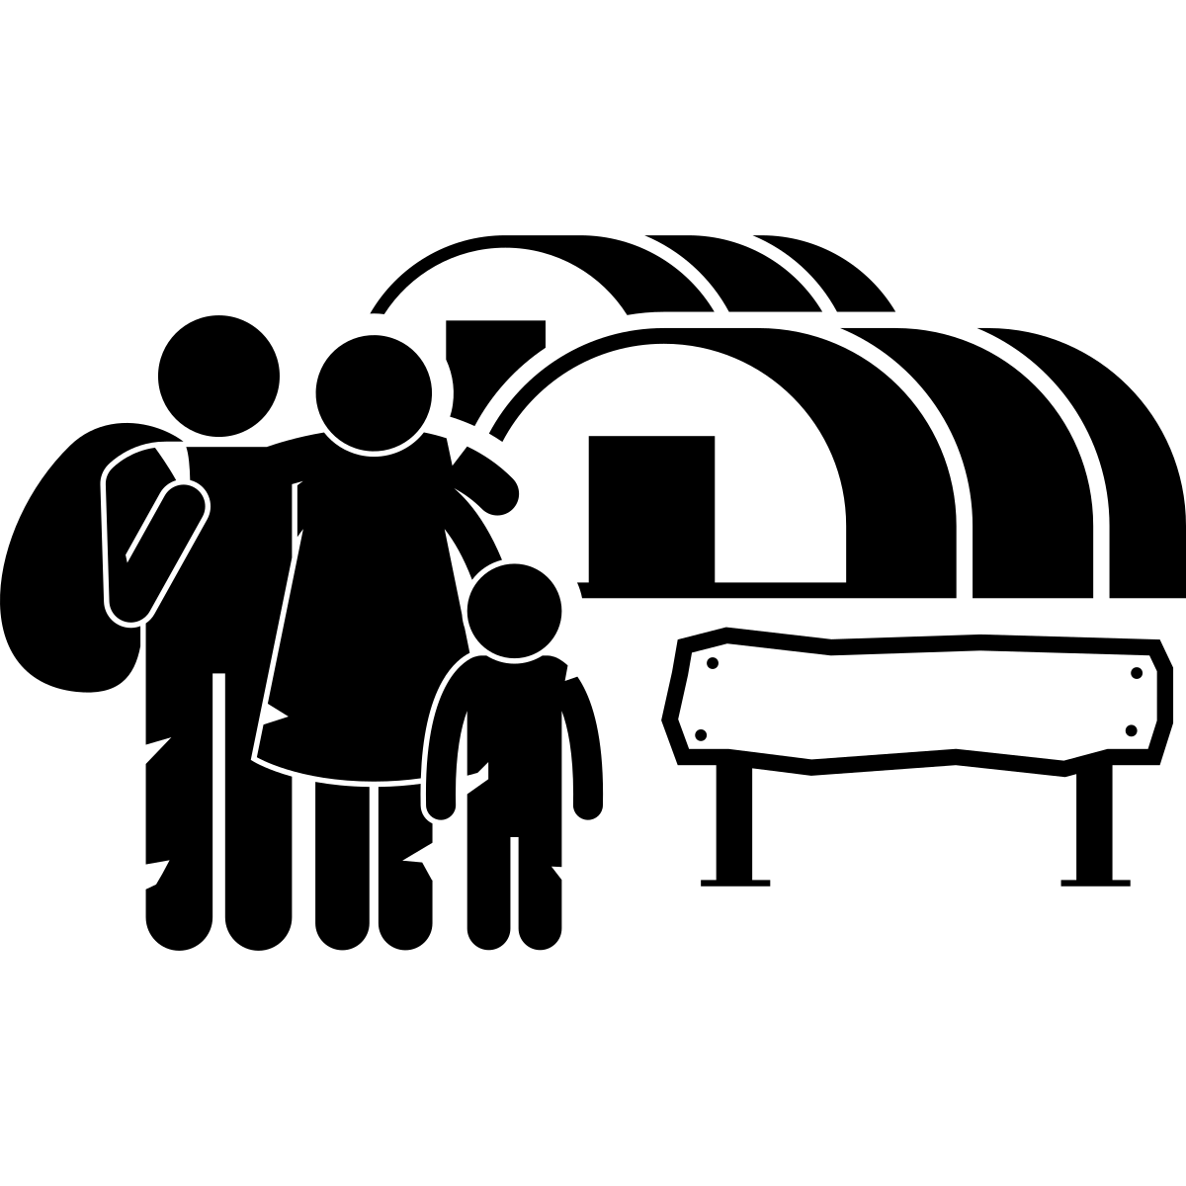

Year 7 - Knowledge Organiser - Term 3A
Migration
 | Key Term | Definition
1 | Settlement | A place where people live, e.g. a town.
2 | Urban | Relating to built-up areas where people live, e.g. towns and cities are urban areas.
3 | Rural | Relating to areas of countryside, e.g. mountains and forests.
4 | Migration | The movement of people from one place to another to settle (live) there.
5 | International migration | Migration of people from one country to another country.
6 | Internal migration | Migration of people within a country.
7 | Urban sprawl | The growth of urban areas into surrounding rural areas.
8 | EU | The European Union, a group of countries in Europe that share certain laws.
9 | Civil war | A war between different groups within a country.
10 | Refugee camp | An area used for temporary accommodation of refugees.
1. Settlements
Megacity: A city with over 10 million people.
City: A large settlement, larger than a town.
Town: Larger than a village, typically home to 10,000s of people.
Village: Small settlement, up to a few 1000 people
Hamlet: Smaller than a village, a few houses.
2. Types of migration
Emigration: Moving away from an area.
Immigration: Moving into an area.
Refugee: A person that has been forced to migrate, e.g. due to an earthquake.
Asylum: Protection given to refugees by a country. Asylum seekers are refugees who are looking for protection in another country.
3. Push and pull factors
Push factors are reasons people leave a place:
Lack of jobs
Poor healthcare
Lack of services e.g. electricity
Pull factors attract people to a place, e.g.:
Lots of job opportunities
Access to entertainment e.g. cinemas
4. Urbanisation
Urbanisation is the increase in proportion of people living in urban areas.
Rural–urban migration is the migration of people from countryside to towns and cities.
Birmingham experienced rapid urbanisation between 1840 and 1940. Mumbai is a megacity in India still growing rapidly.
5. Birmingham
People from many different places and cultures have migrated to Birmingham, including Irish, Jewish and Chinese. Migration has led to opportunities and challenges.
Opportunities Diverse culture, e.g. restaurants, festivals Migrants bring skills and carry out jobs Taxes paid contribute to the economy | Challenges Cultures do not always mix across the city More homes needed, urban sprawl Conflict risk due to perceived differences
7. International migration - UK
In 2019, 14% of the UK’s population were born outside of the UK.
The largest non UK nationality is Indian.
Since leaving the EU, the UK’s policy on migration has changed. Now, migrants to the UK have to meet specific criteria.
8. Refugees
Refugees are forced to leave their country for reasons like war and natural disasters. In 2020 the number of refugees reached 20.3 million.
Syria is the country which has had most refugees leaving, fleeing the civil war.
Turkey is the country hosting the most refugees, many in refugee camps.
Geographical skills I have used in this topic:
Flow line maps
Image analysis
Stakeholder analysis
Line graph
Notes:
Plastic
Ivory
Extracted
Microplasic
Landfill
Recycle
Toxic
Upcycle

